Slide 1
Mouse Genome Informatics
www.informatics.jax.org
June 2017

Slide 2
Why mice?
>95% similarity to human genome
Second mammal sequenced after human
Among the first mammalian species to have its genes manipulated with molecular tools
Many disease-related genes are nearly identical, sharing many common genetic features, such as genetic pathways, physiology, anatomy, and metabolism
Animal-based studies in precision medicine
Knockout Mouse Project (KOMP), International Mouse Phenotyping Consortium (IMPC)
Systematic, comprehensive, large scale studies
Frank et al. (1999)

Slide 3
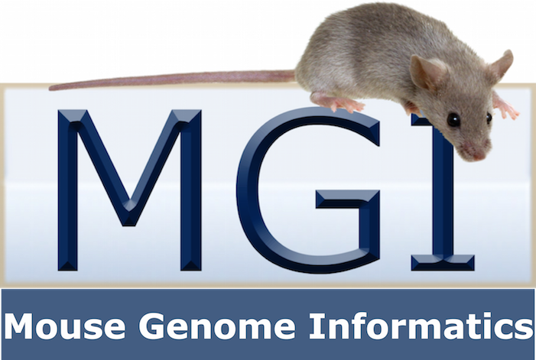
What is MGI?
Mouse Genome Informatics (MGI) is a community model organism database for the laboratory mouse
Authoritative resource on the laboratory mouse
Mouse gene, allele, and strain nomenclature
Unified mouse genome feature catalog
Developmental gene expression data
Functional, phenotype, and disease annotation using specific ontology
Mouse models of human disease
All information relies on peer-reviewed sources and is curated by scientists
One-stop integration of genes, alleles & biology making it flexible for a variety of research questions

Slide 4
What can you do at MGI?
Search for genes according to diverse biological attributes
Genome location
Expression
Function
Phenotype
Find mouse models of human disease
Find mouse and ES cell resources
Compare gene structure and transcript annotation from NCBI, Vega, and Ensembl
Link out to information in related resources
Protein structure, Gene family/orthology, Pathways, Human gene information
Notes:
MGD compares/integrates predictions from Ensembl, NCBI, Havana/Vega, produces unified catalog used by NCBI, IMPC

Slide 5
MGI – Example Content Summary (June 2017)
56,658 Genes (including uncloned mutants)
24,319 Genes with protein sequence data
14,496 Genes with expression assay results
50,845 Mutant alleles in mice
708,853 Mutant alleles in cell lines only
329,137 Gene expression images
60,470 Genotypes with phenotype annotations
1,534 Human diseases with one or more mouse models
24,490 Mouse protein-coding genes with GO annotations
235,245 References
http://www.informatics.jax.org/mgihome/homepages/stats/all_stats.shtml

Slide 6
How to Access MGI?
Quick Search keyword
Web-based search forms
Genome browser (Jbrowse)
MouseMine data mining tool
FTP
Direct database access and programmatic access via web services

Slide 7
Help and Information
http://www.informatics.jax.org
Comments and Questions?
MGI Help Desk
Mailing lists
Facebook @mgi.informatics
Twitter @mgi_mouse

Slide 8
http://www.informatics.jax.org
Menus
Quick Search
Portals
MGI news
Getting Started
Citing MGI

Slide 9
Structured vocabulary
Mammalian Phenotype (MP) ontology
Describes abnormal observations in mutant animals
Used by MGI, IMPC, RGD
Gene Ontology (GO)
Describes normal behavior of a gene or gene product within it’s cellular context (species neutral).
Subdivided into Biological Process, Molecular Function and Cellular Component
Mouse Developmental Anatomy ontology
Describes organs and tissues throughout development
Uses Theiler stages where TS1-26 are embryonic, TS27 is perinatal and TS28 is post-natal adult
Used by MGI/GXD and e-Mouse Atlas
Notes:
…used in MGI

Slide 10
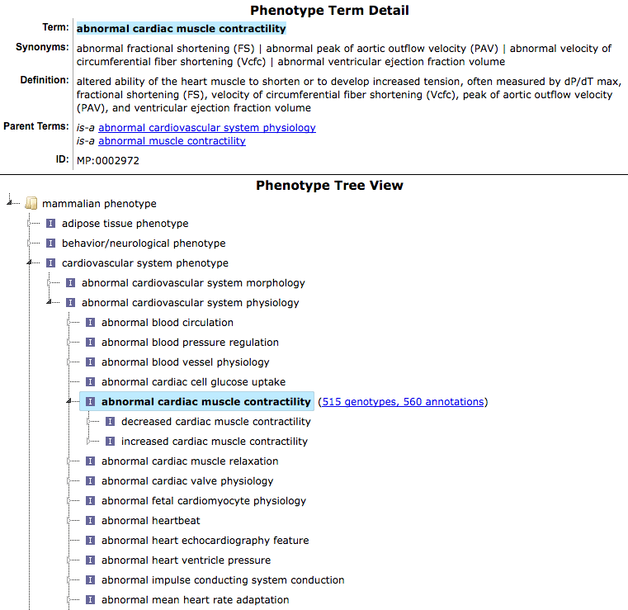
Structured vocabulary
Provides unique, stable and well-defined identifiers
Can be read by a computer
Allows comparisons
Hierarchical relationships between terms
Variable levels of precision for data annotation and retrieval
Mammalian Phenotype Ontology

Slide 11
Quick Search

Slide 12
Apoe

Slide 13
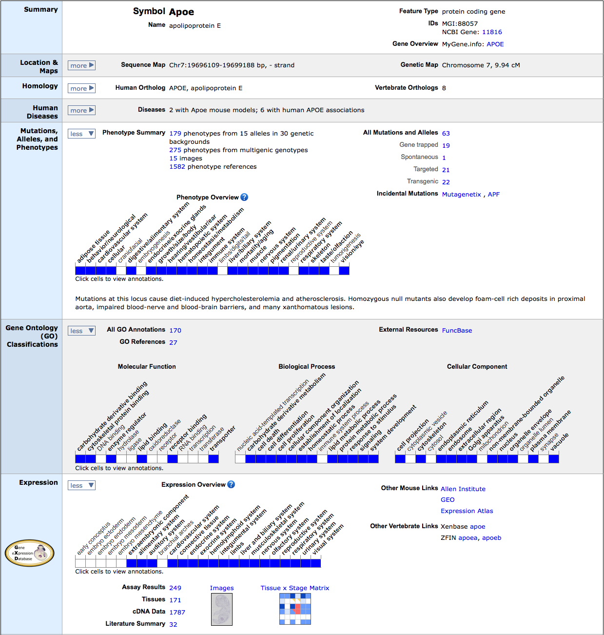
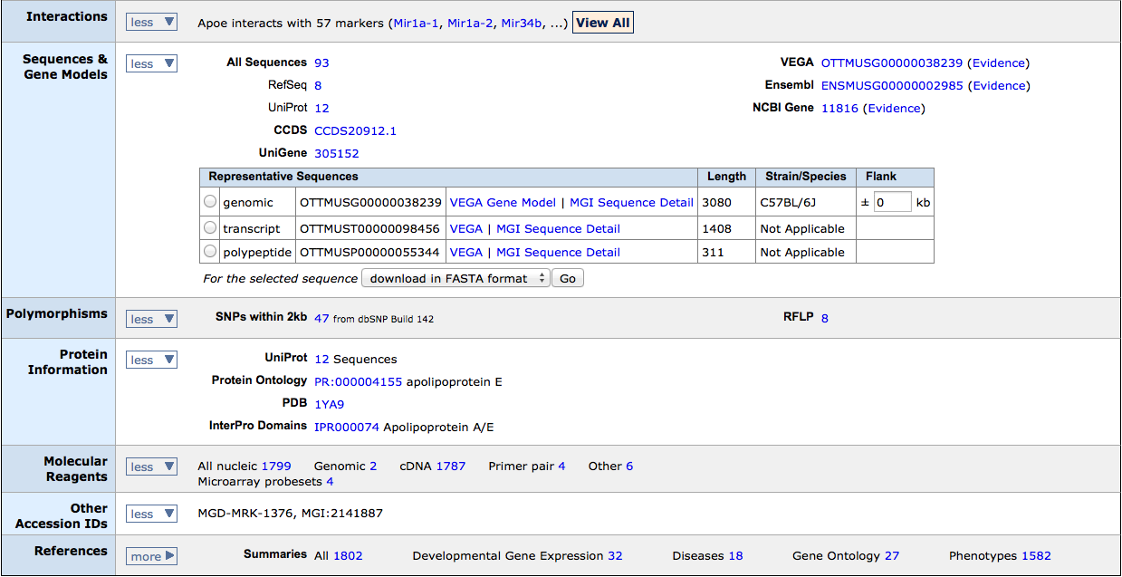
ID & synonyms
Position & homology
Diseases &
alleles
Function (GO)
Expression &
interactions
Sequences & polymorphisms
Protein links &
reagents
References

Slide 14
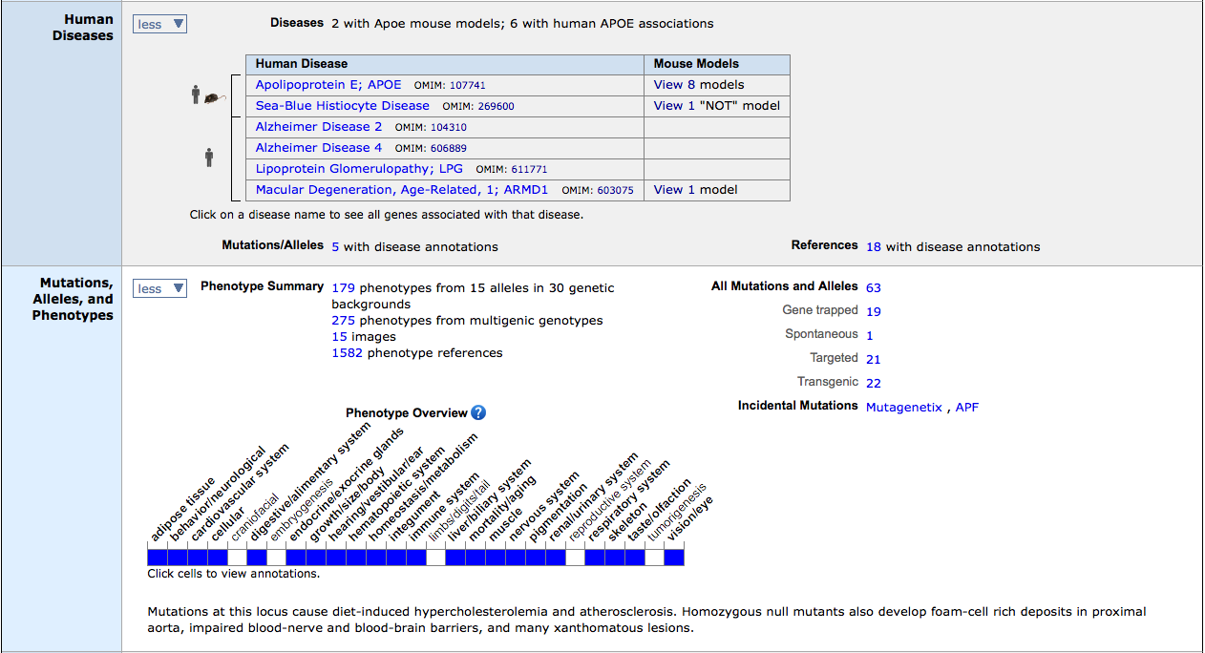
Alleles, phenotypes and associated diseases
Phenotype ribbon
Mutation Summary

Slide 15
ID & synonyms
Position & homology
Diseases &
alleles
Function (GO)
Expression &
interactions
Sequences & polymorphisms
Protein links &
reagents
References

Slide 16
ID & synonyms
Position & homology
Diseases &
alleles
Function (GO)
Expression &
interactions
Expression ribbon
Sequences & polymorphisms
Protein links &
reagents
References

Slide 17
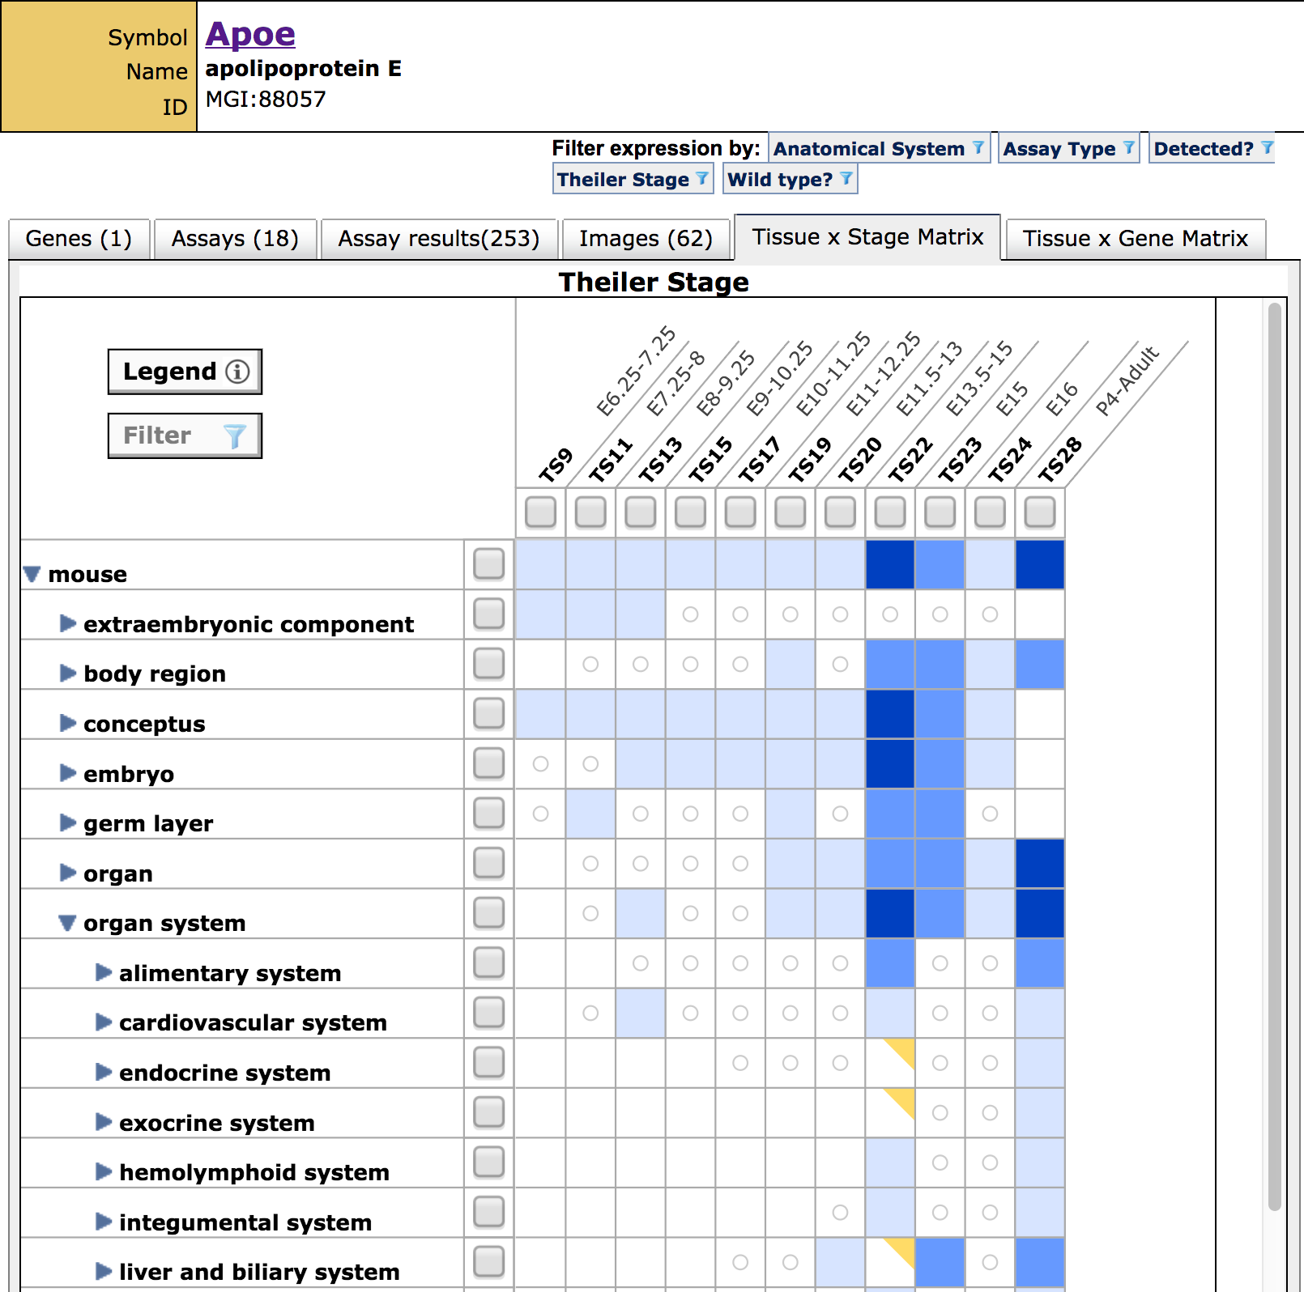

Slide 18
Find your mouse models

Slide 19
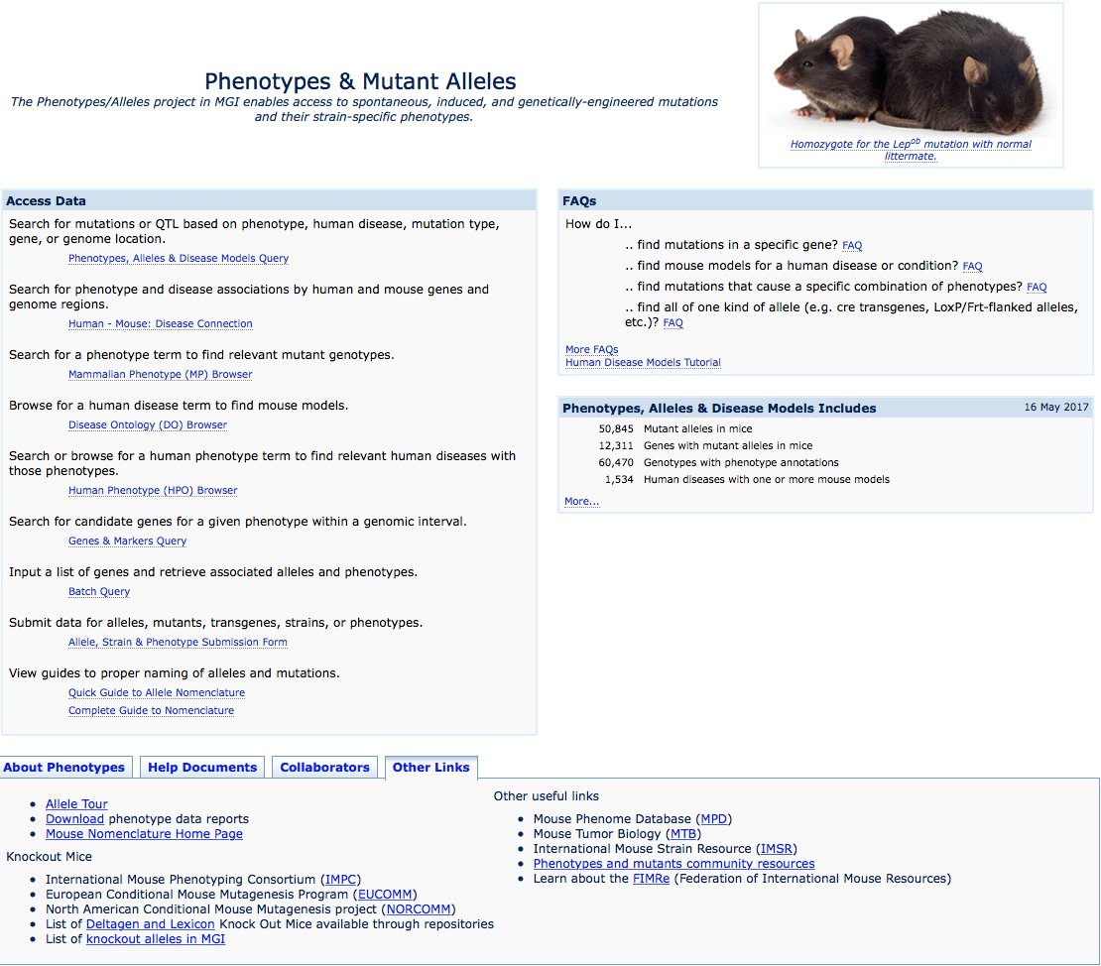
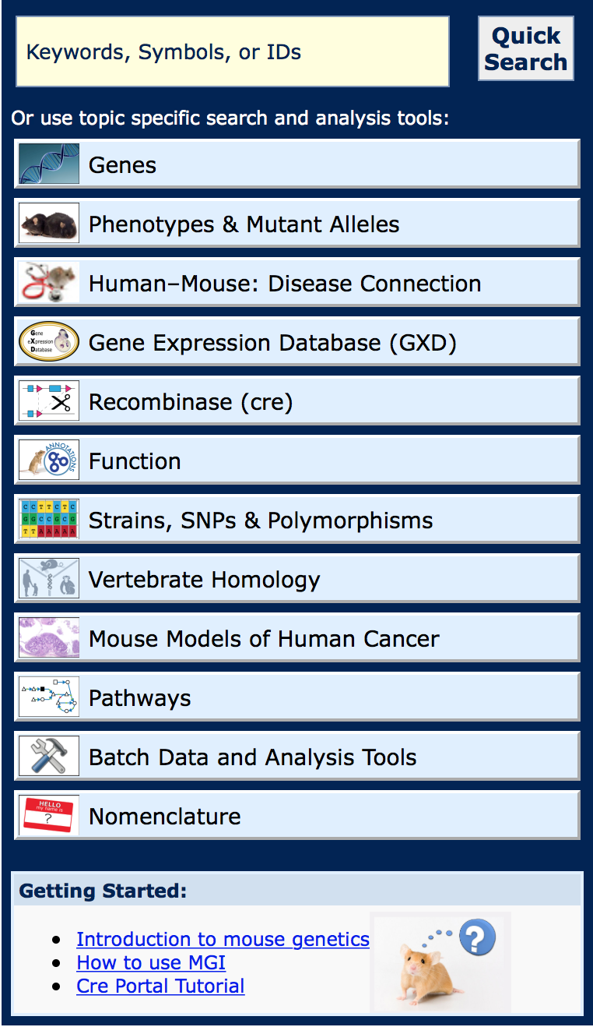
Find your mouse models
1
3
2
Notes:
Just a few of the many ways to look for mouse models on MGI

Slide 20
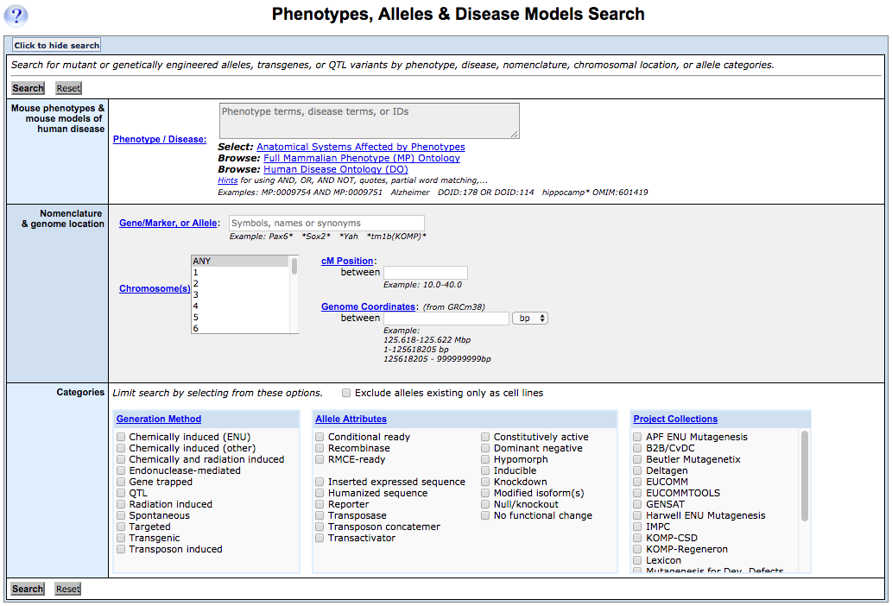
Find your mouse models (1)
explore terms and IDs here
look up definitions here

Slide 21
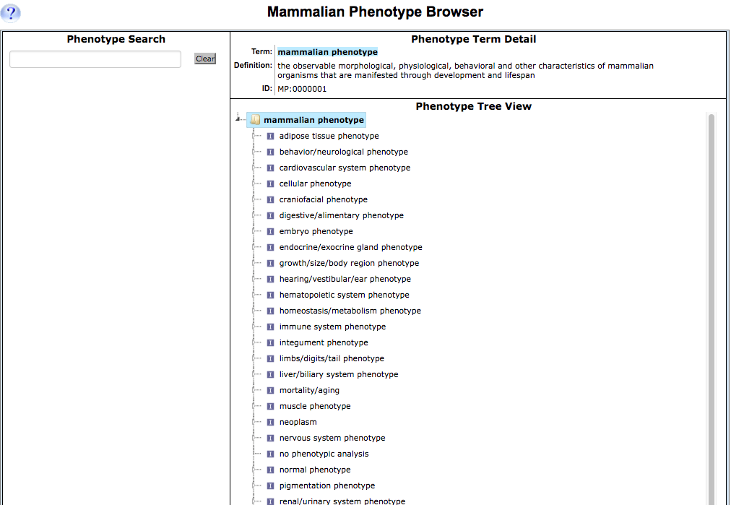
Find your mouse models (2)
Help doc.

Slide 22
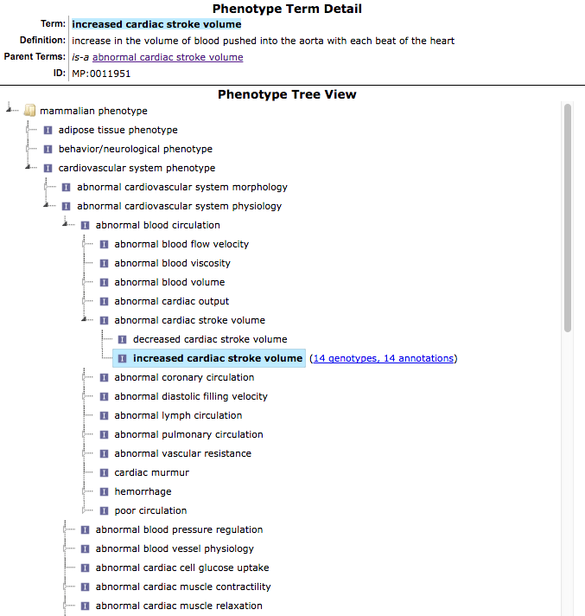
Find your mouse models (2)

Slide 23
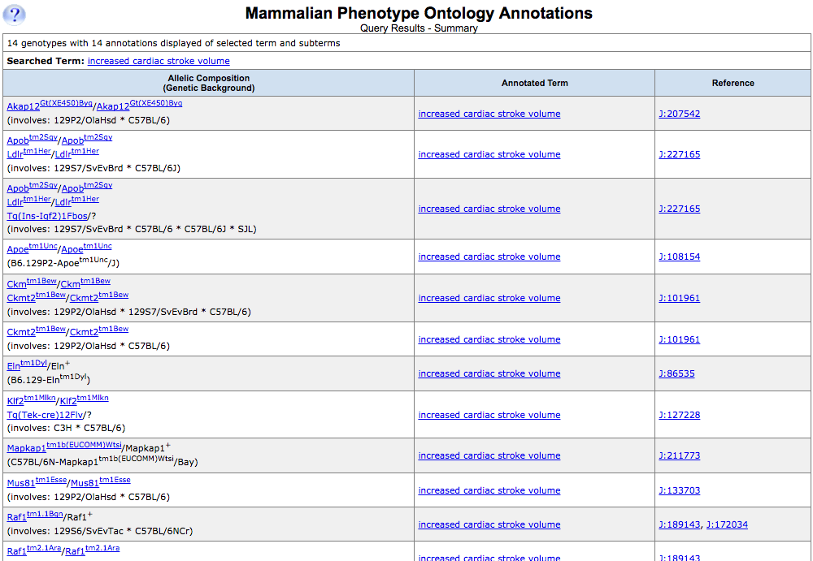
Find your mouse models (2)
* phenotypes are annotated to genotypes
* publication info. and abstracts

Slide 24
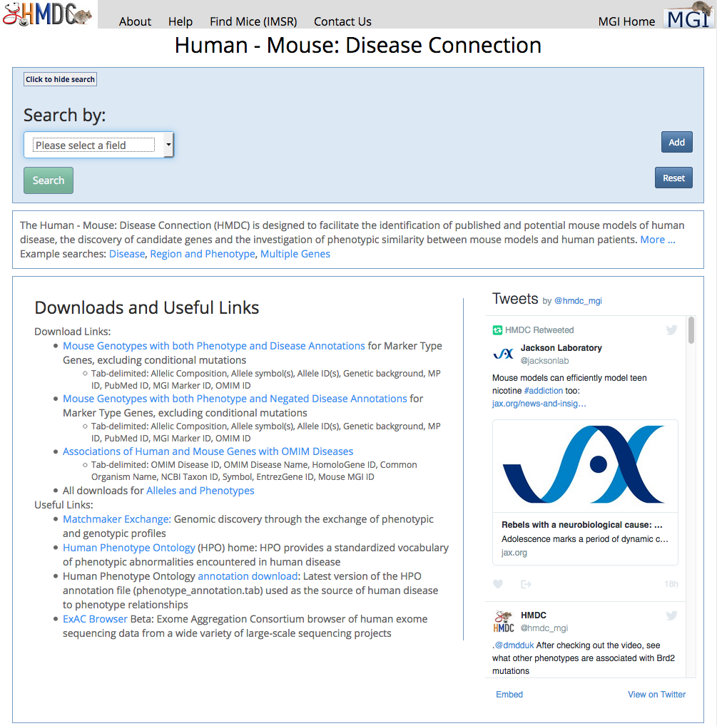
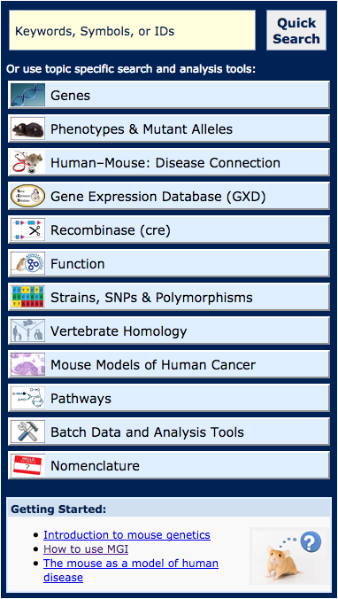
Find your mouse models (3) – on HMDC

Slide 25
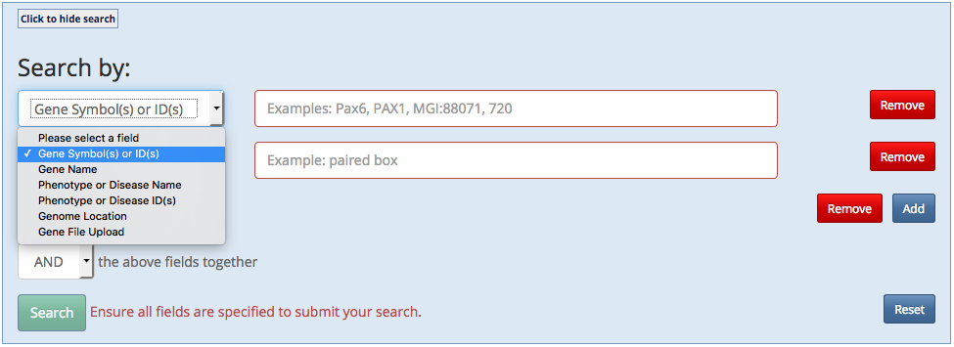
beginning a search with list of genes
SP-B, SP-C, ABCA3, GM-CSF, TTF1
Notes:
Running a quick “genes” search with these 6 genes

Slide 26
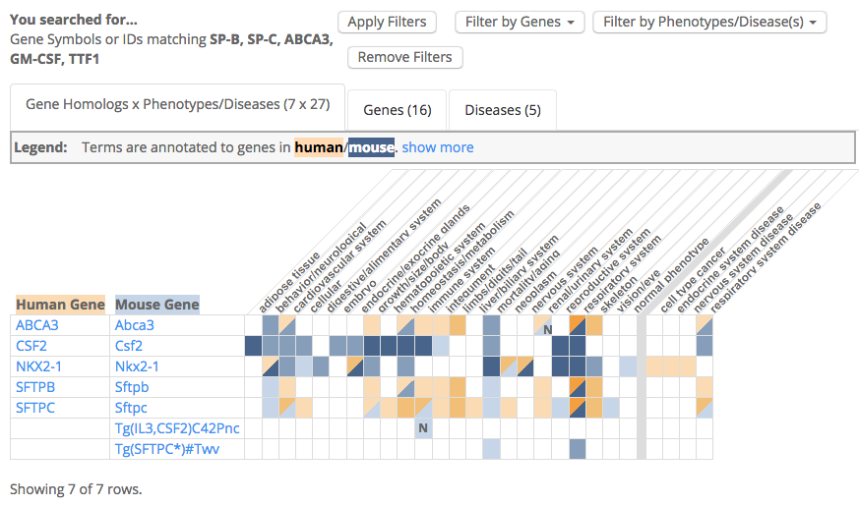
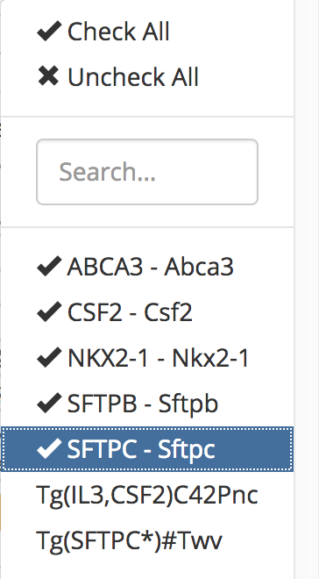
Visual display of associated phenotype and disease results
Mammalian (mouse) and human phenotypes
Disease Ontology (DO)

Slide 27
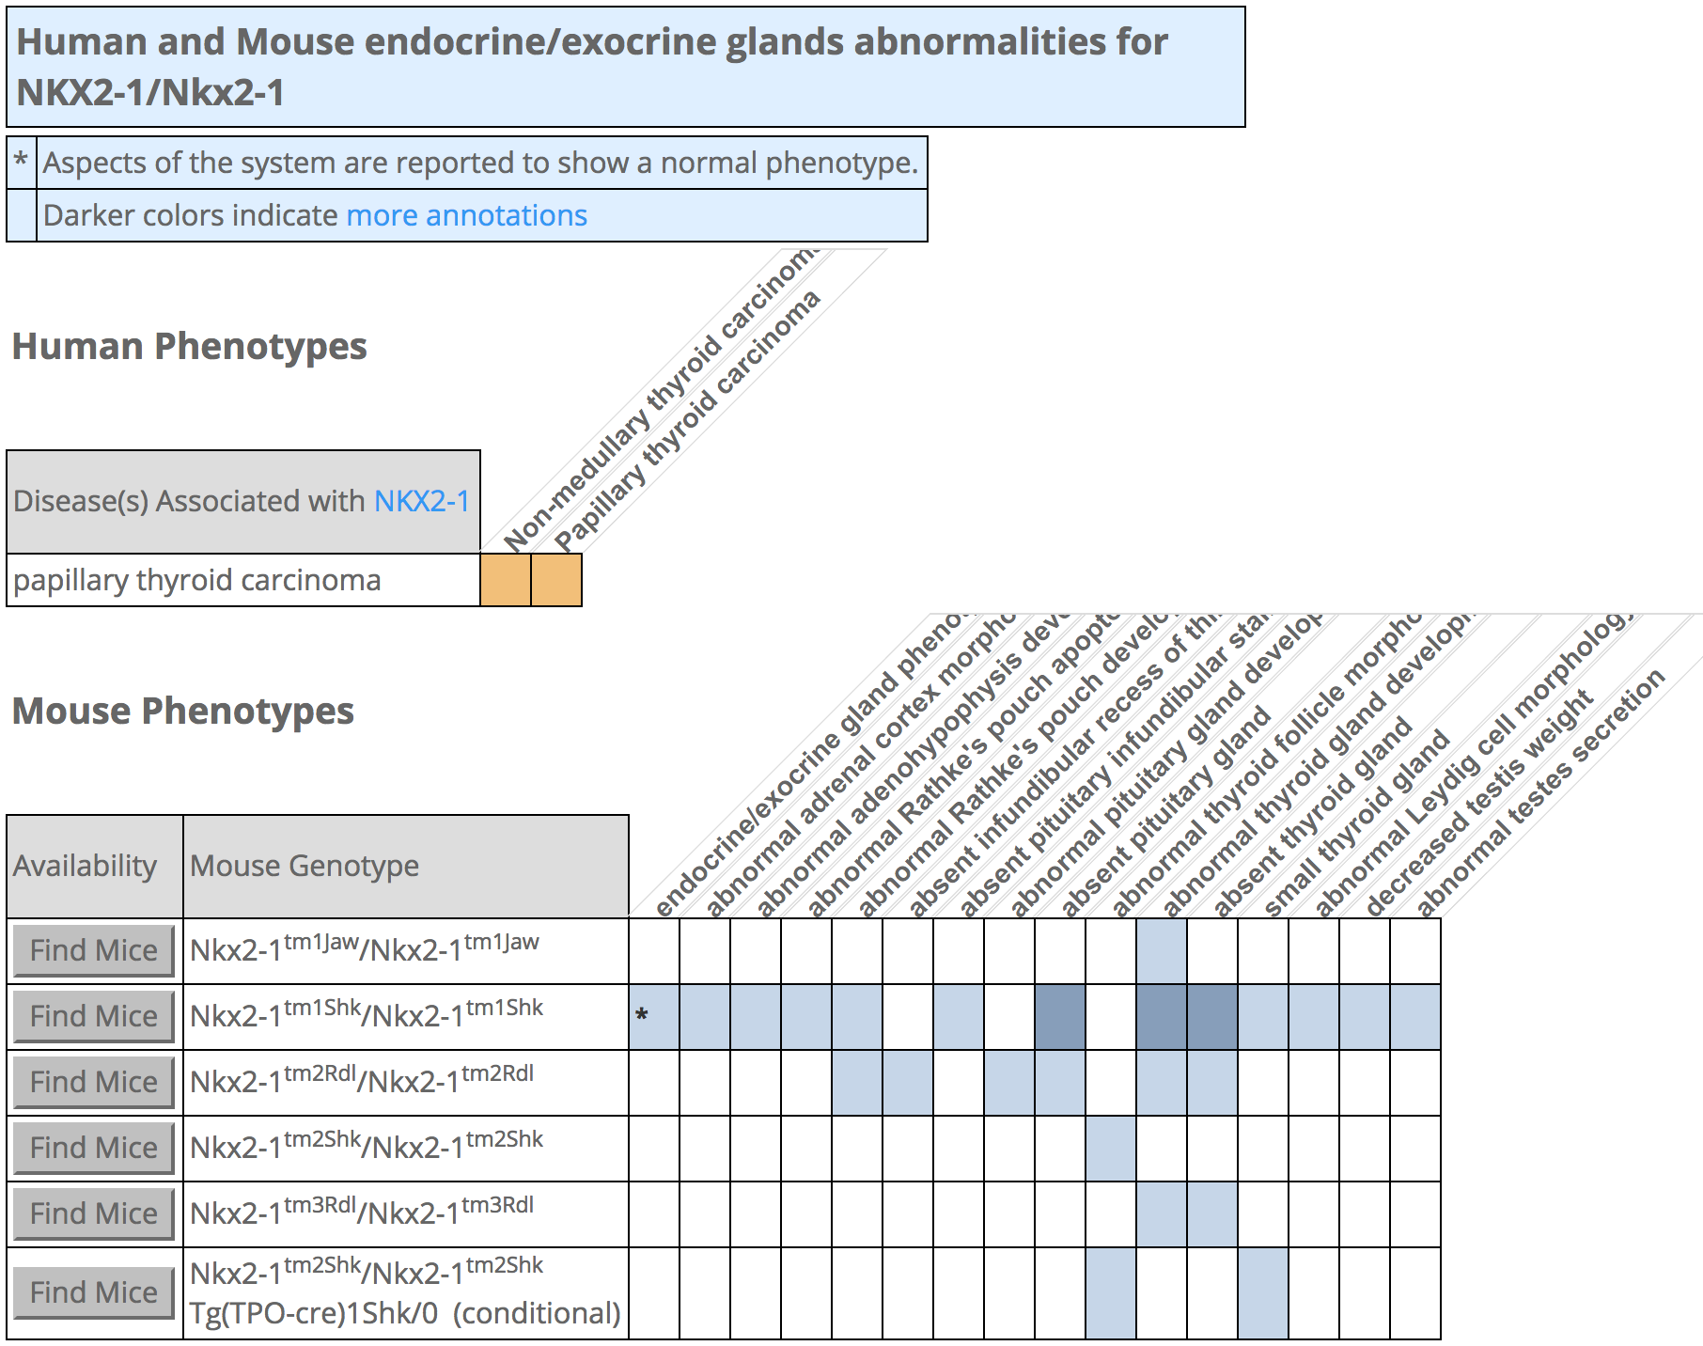
Click on shaded cells to drill down for specific genotypes and more precise phenotypes

Slide 28
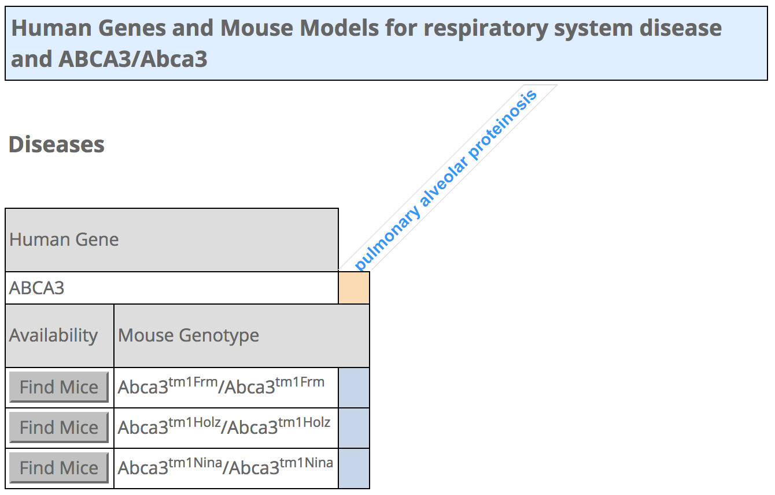
Click right side to view disease
Notes:
Similarly, on the right side of the grid, clicking the cells with data will reveal the details of gene-disease associations. Gap junction 9 is an example of a gene which has been associated to cataracts in both humans and mouse, and you can see that four different alleles in the mouse have all been used as cataract disease models.

Slide 29
Other tabs for Genes & Diseases lists (downloadable)
Notes:
Along with the grid, I’ll remind you that there is also a Genes and Diseases tab.

Slide 30
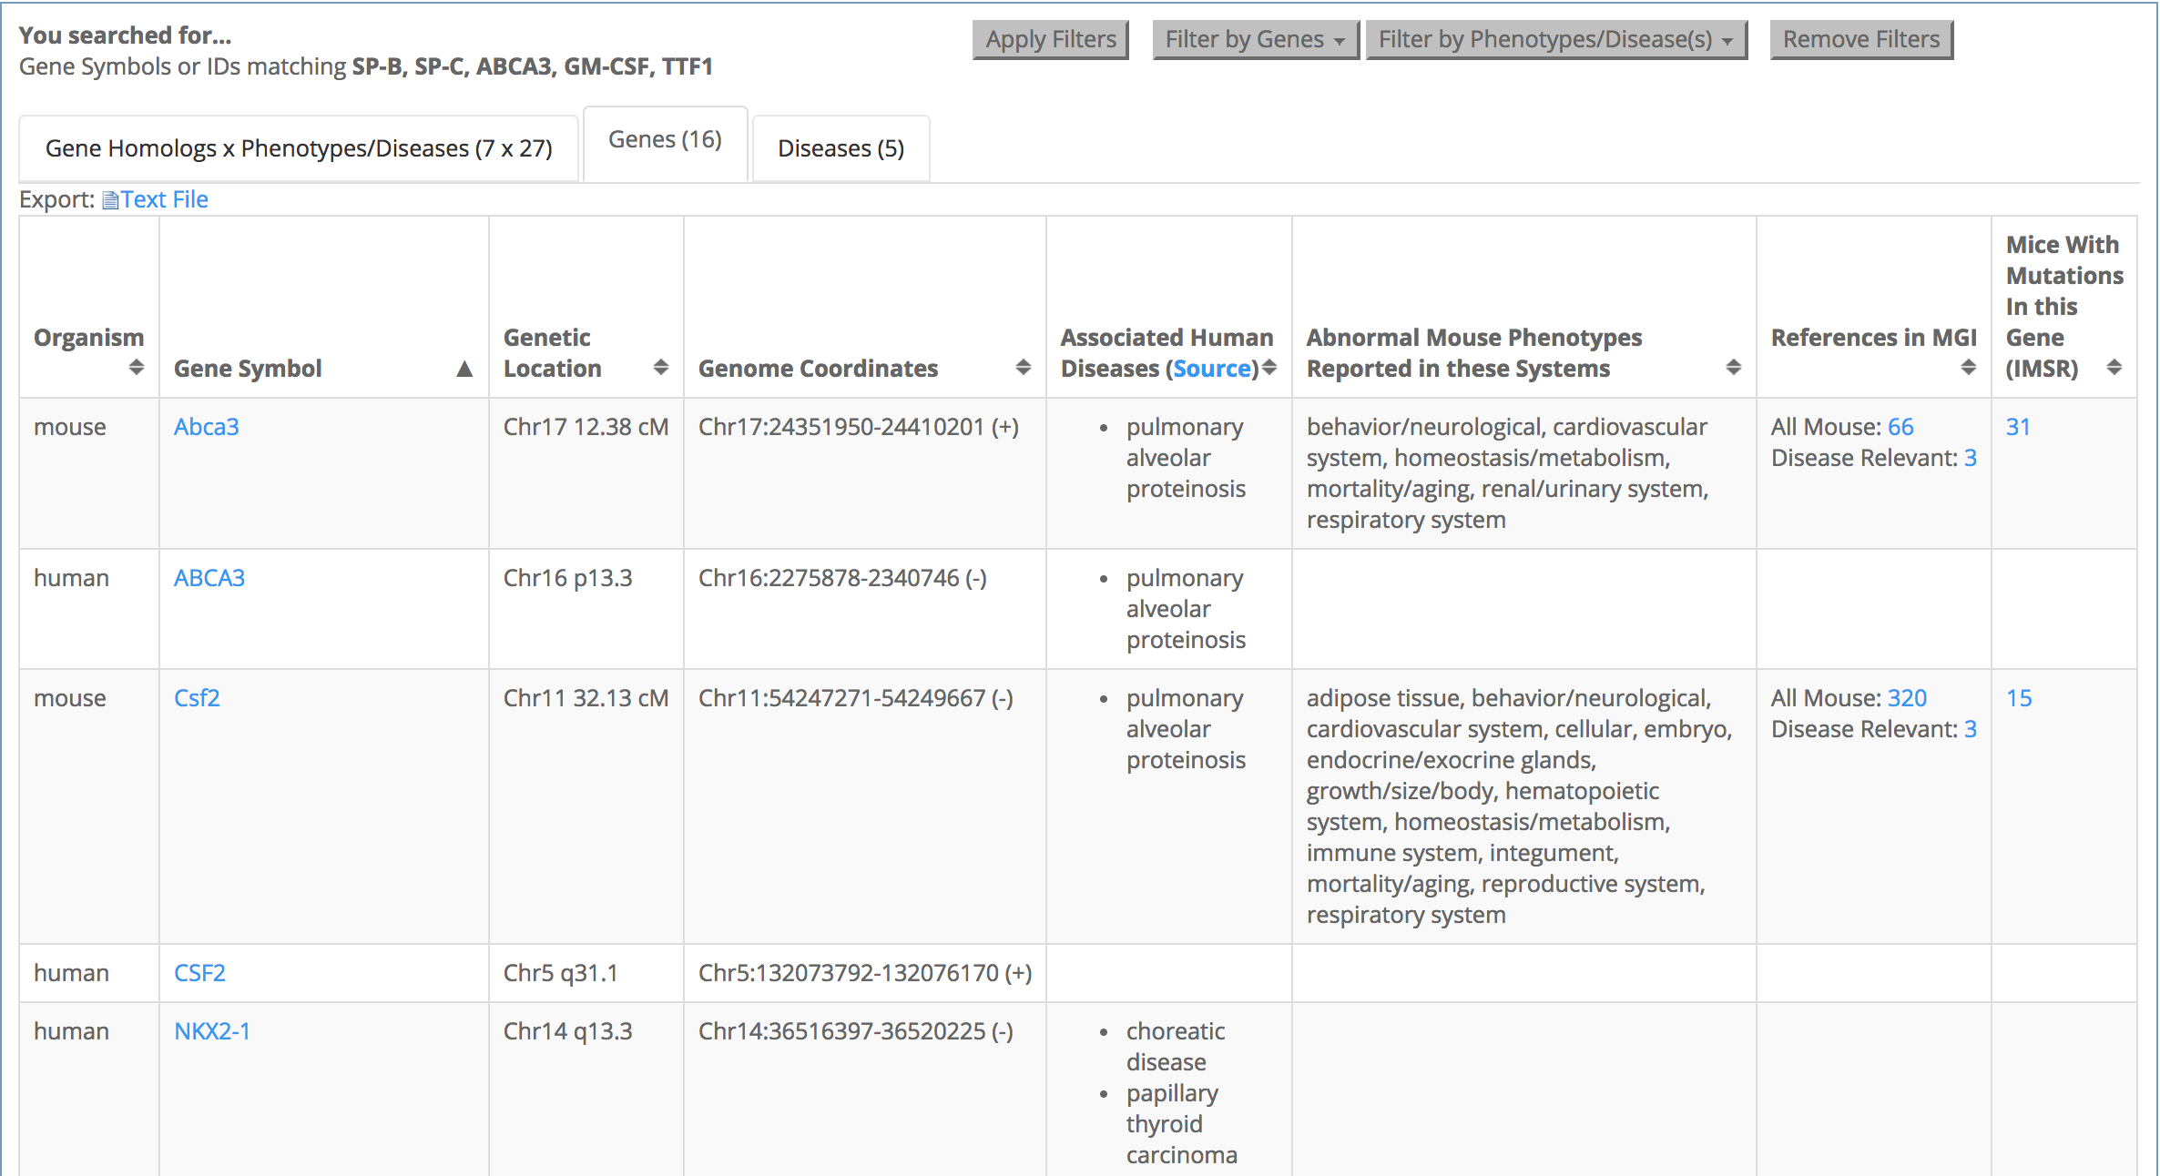
Genes tab: downloadable, find references and mouse models

Slide 31
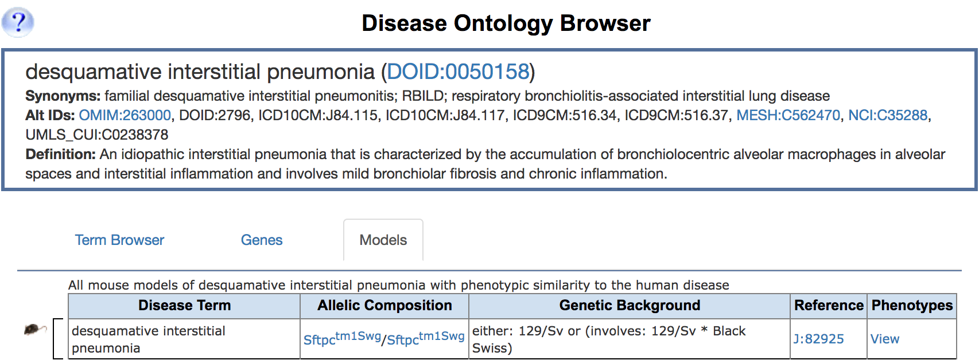
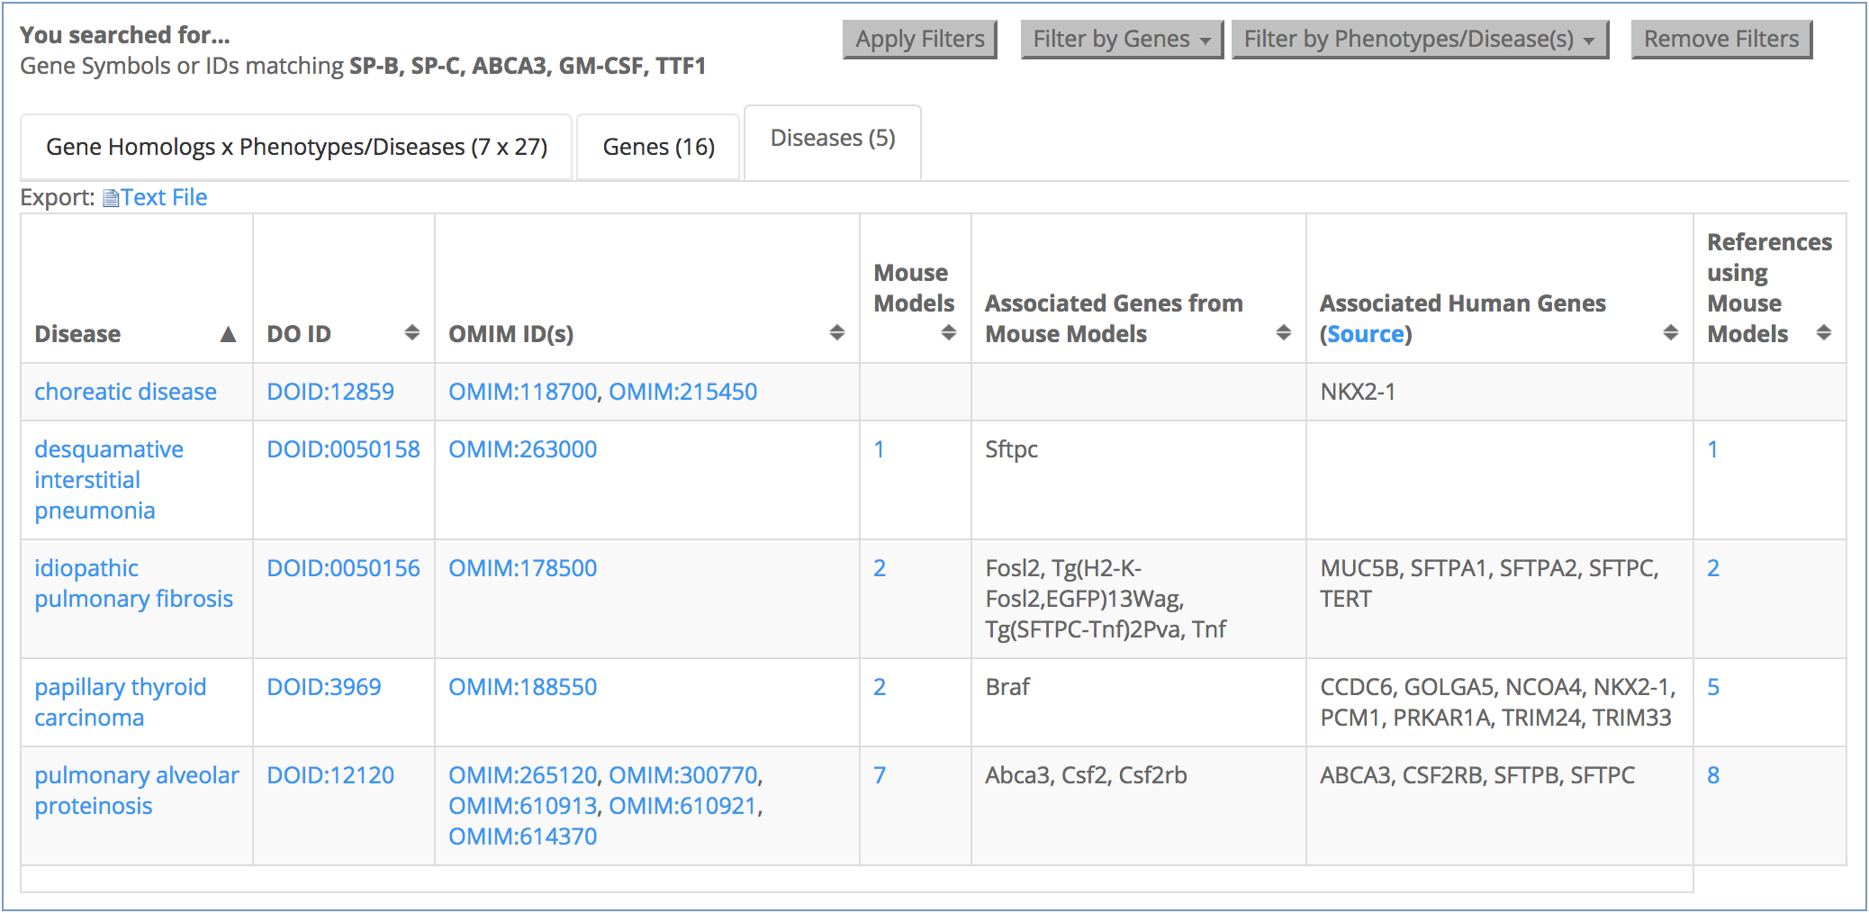
Diseases tab: downloadable, find all gene associations in human and mouse

Slide 32
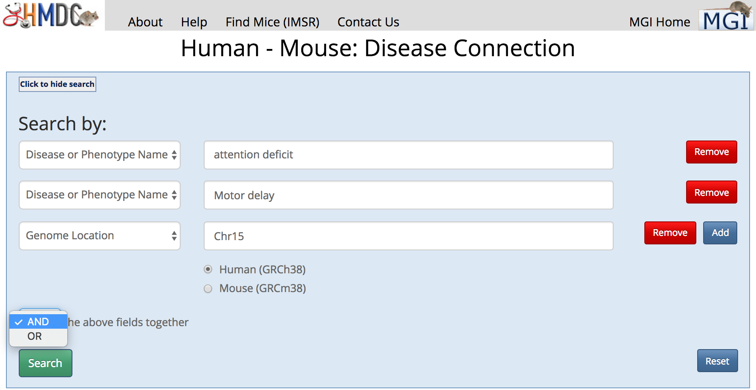
-- begin a search with phenotype term and genome coordinate
Find your mouse models (3) – on HMDC
Notes:
Running a quick “genes” search with these 6 genes
Holoprosencephaly - Chr2 q14.2 Chr2:120797291-120992653 (+)

Slide 33
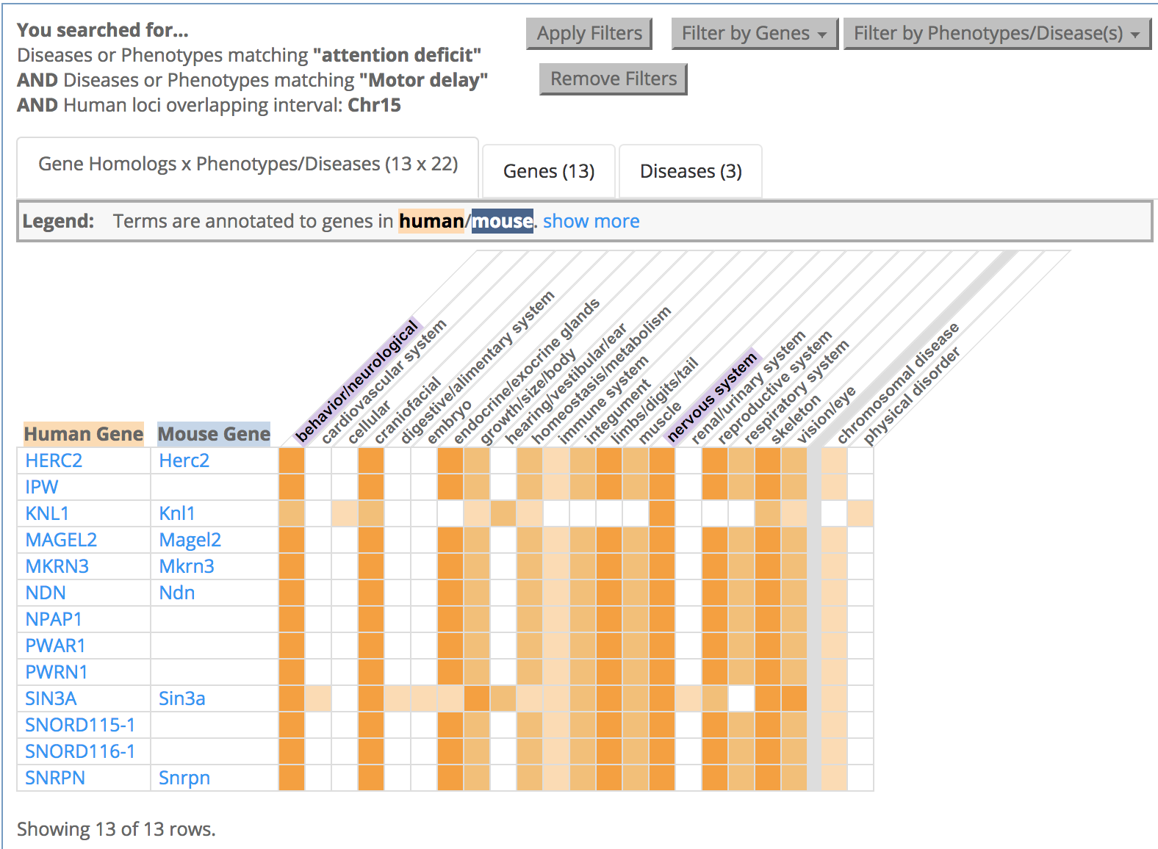
Combined search results
at least one mouse homolog genotype contains “attention deficit” and “motor delay” (or child term) as an MP annotation
same MP genotype is a disease model, or human disease name/synonym contains “attention deficit” and “motor delay”

Slide 34
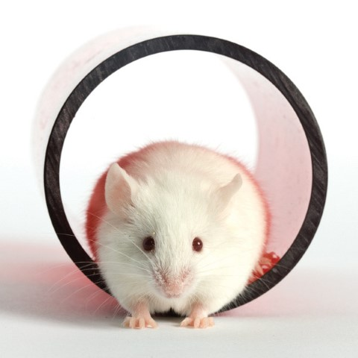
Where to buy ?

Slide 35
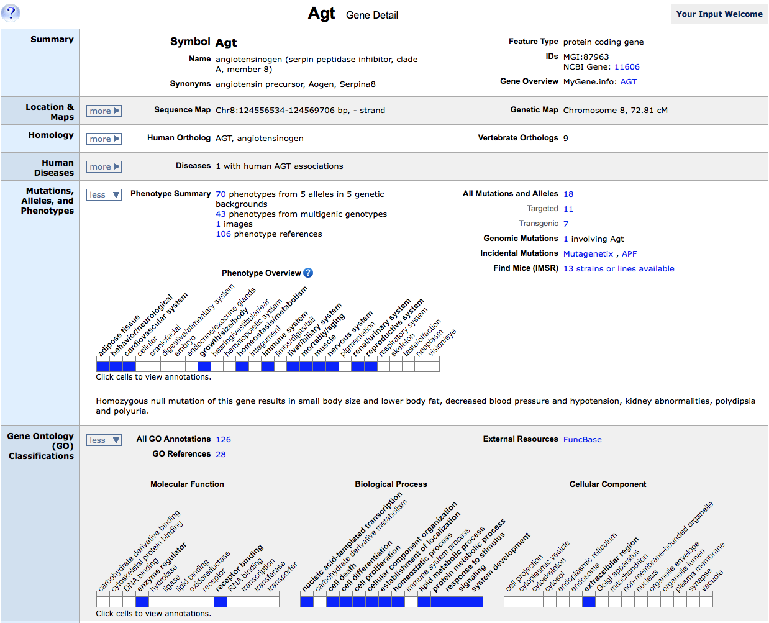
On gene detail page…

Slide 36
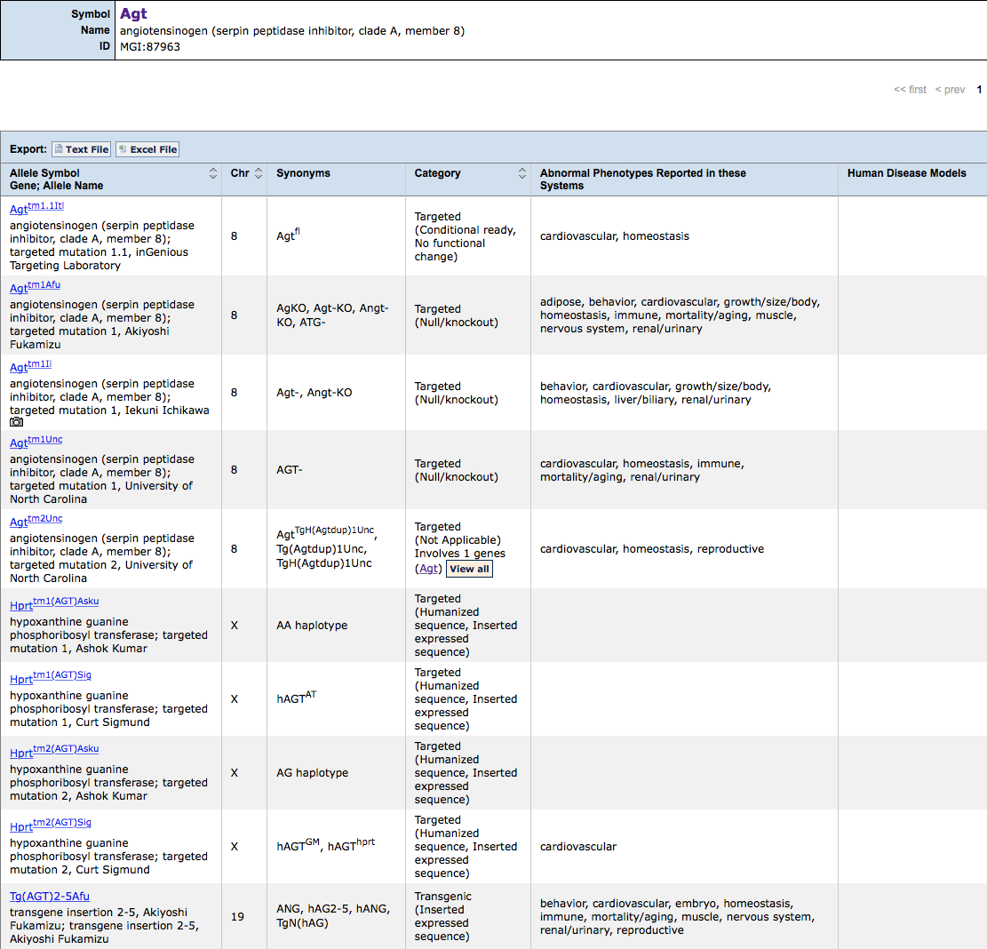
choose an allele

Slide 37
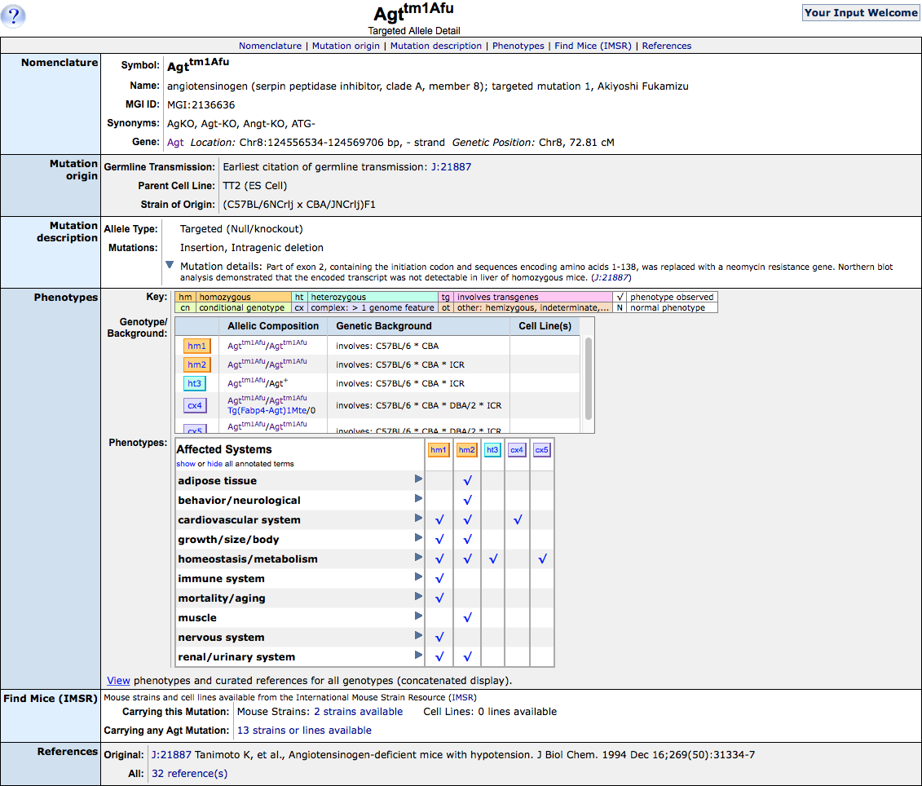
Synonyms are alternative symbols used in publications and are non-specific.
Instead, please use official symbol, e.g. Agt<tm1Afu>, or unique identifier such as MGI ID, e.g. MGI:2136636 for this allele
Click to go to IMSR

Slide 38
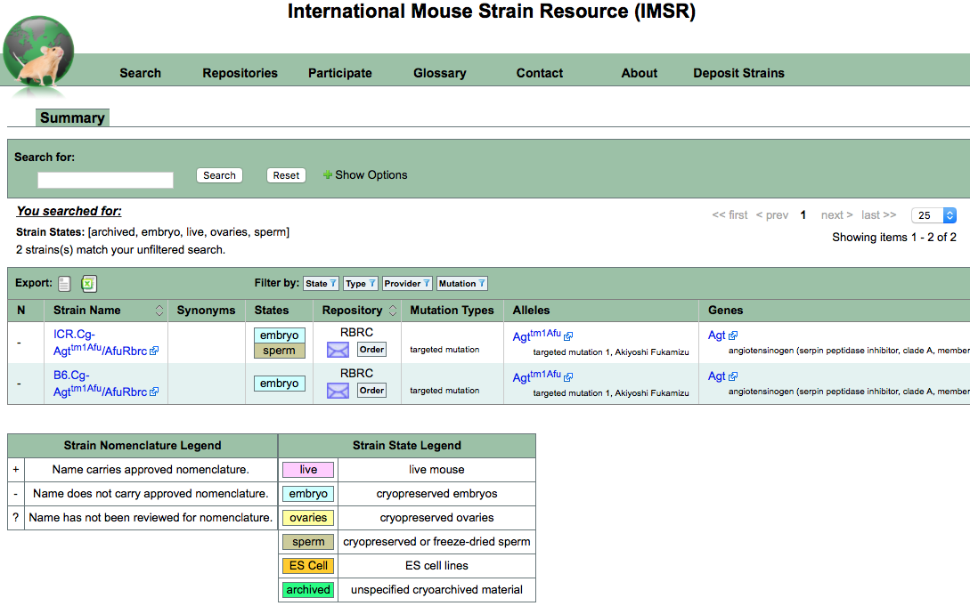
Click to order from repositories
or email them for information

Slide 39
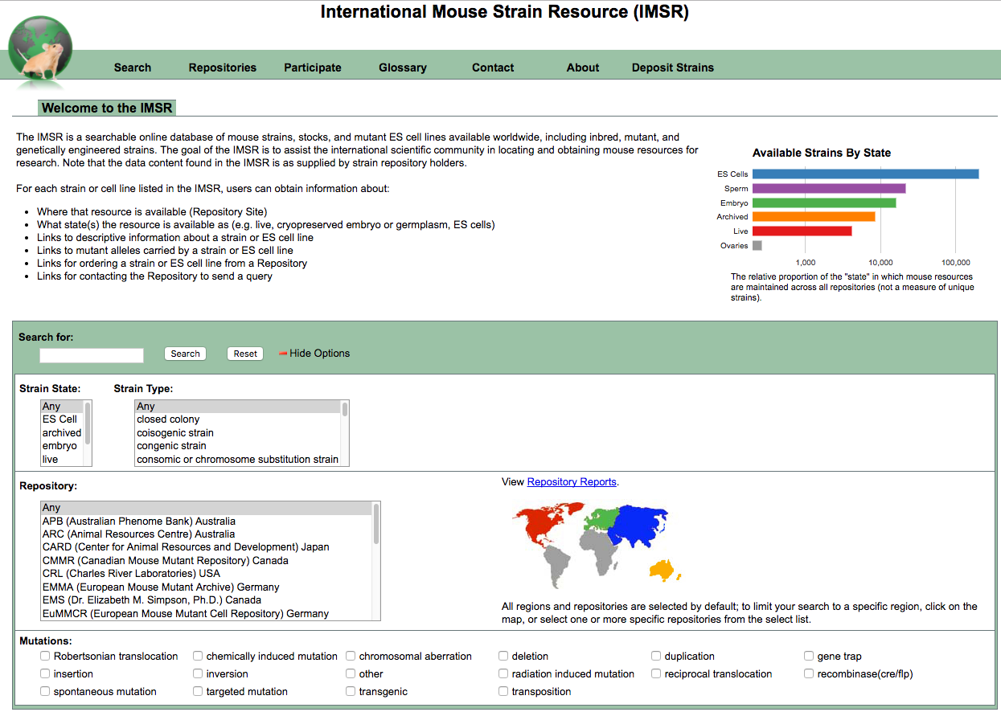
Alternatively, go to…
Agt

Slide 40
Gene Expression

Slide 41
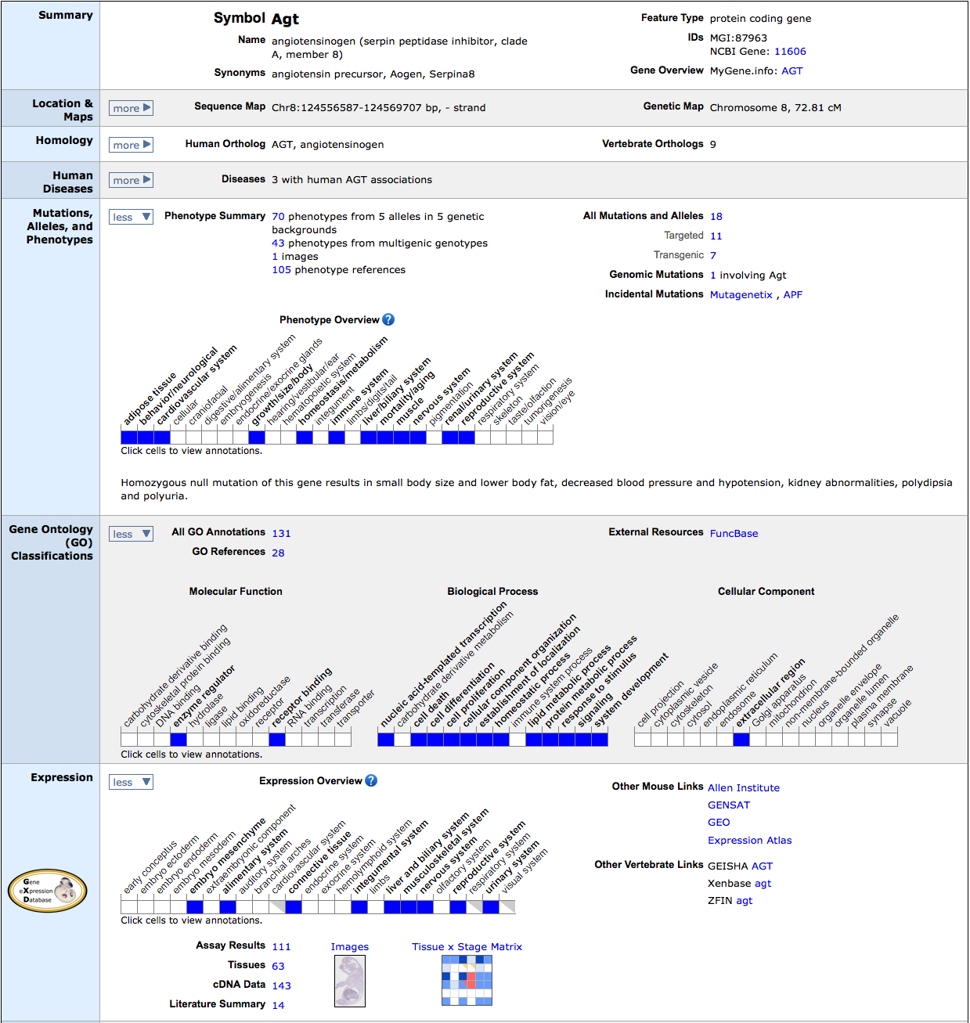
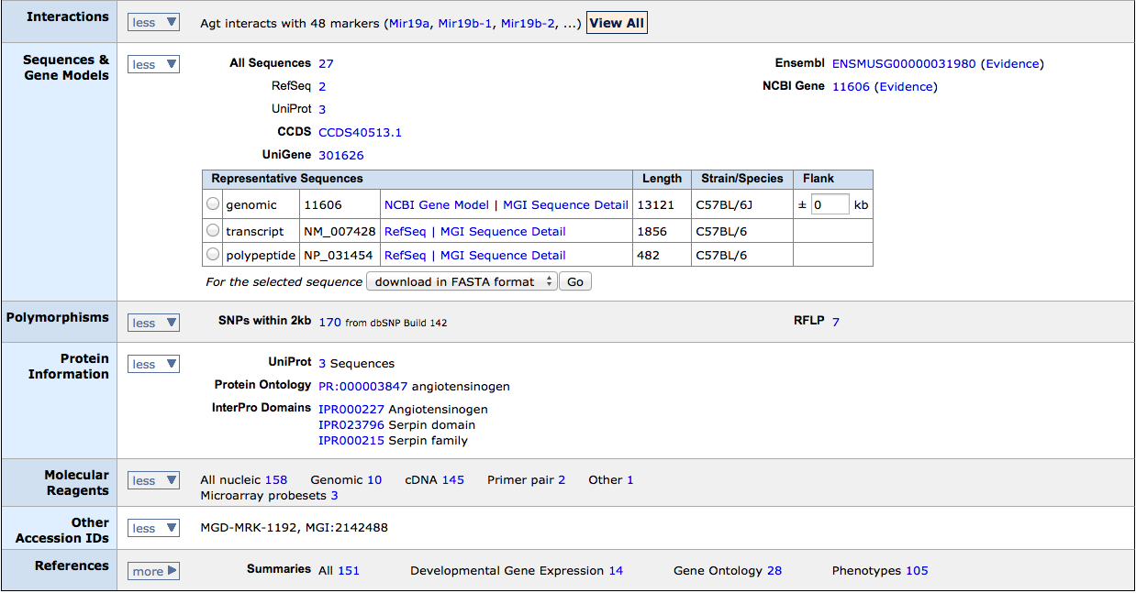

Slide 42
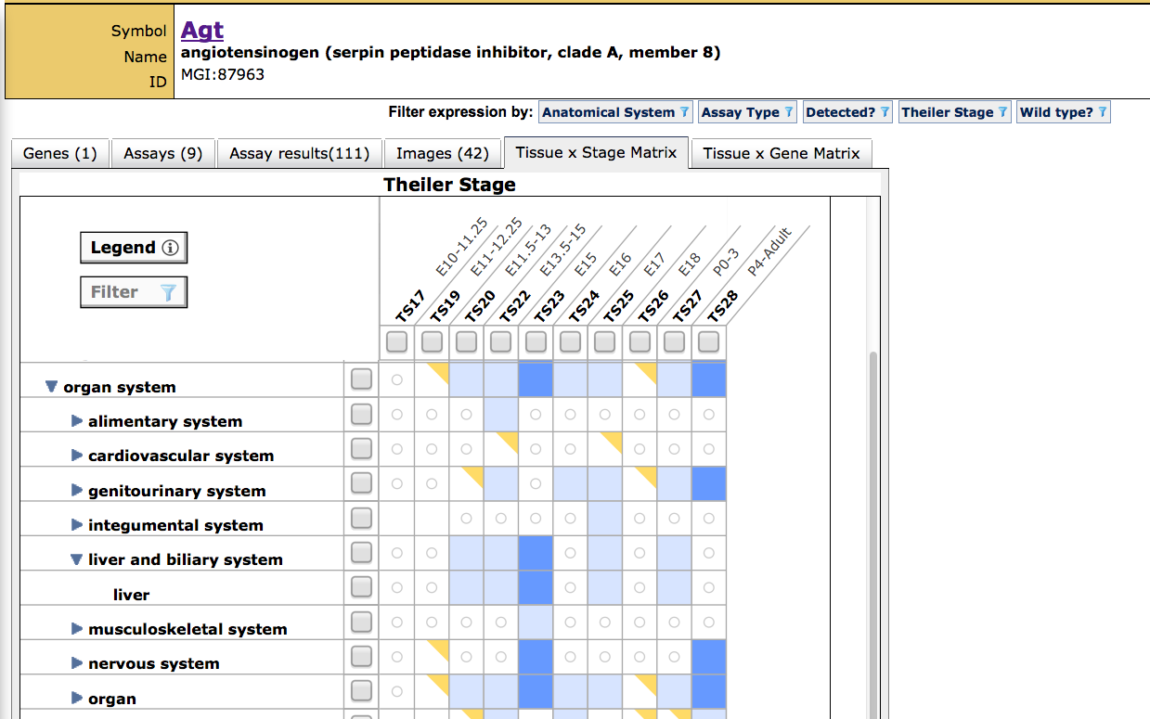
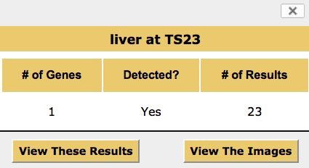
Tissue x Stage matrix of gene expression

Slide 43
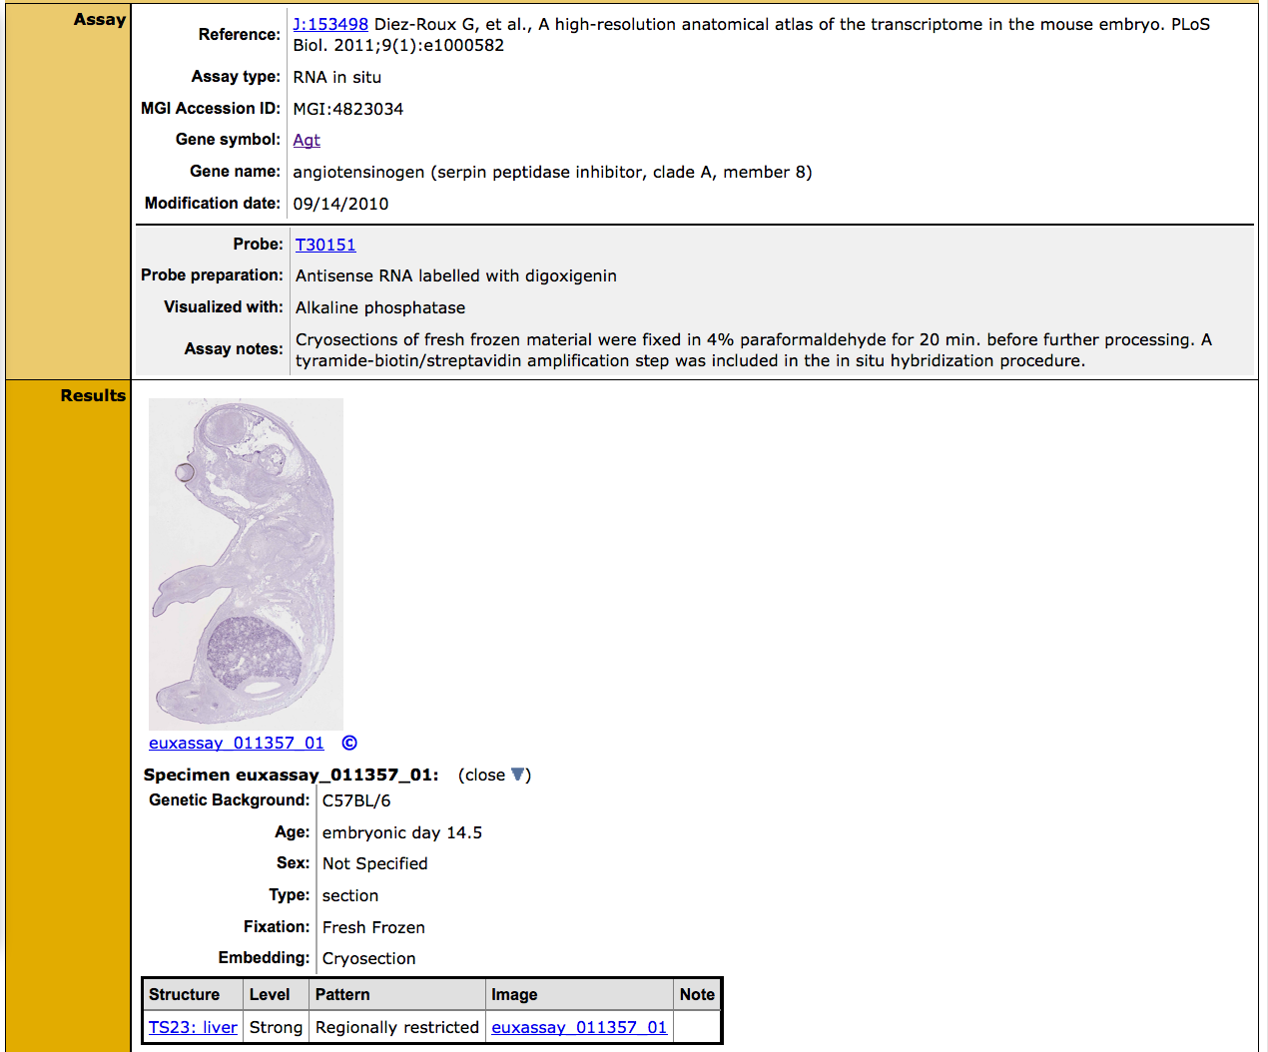
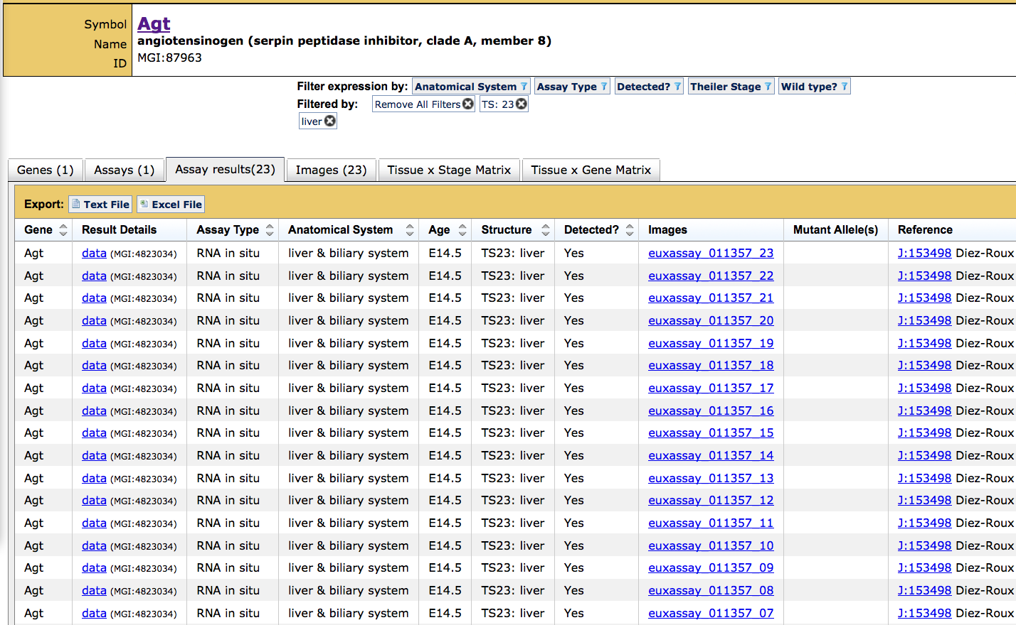
Clicking “view results” applies filters and navigates to a data tab

Slide 44
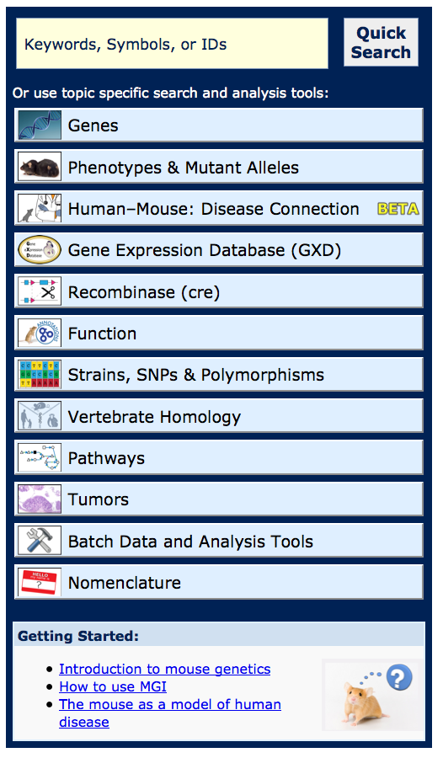
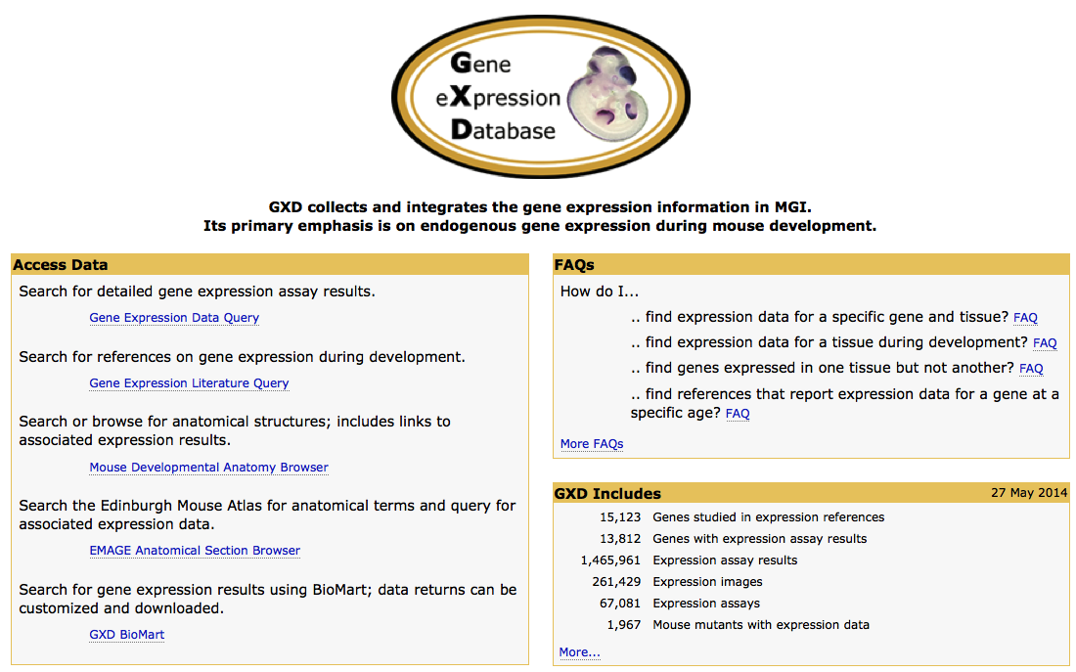
The Gene Expression Data Query

Slide 45
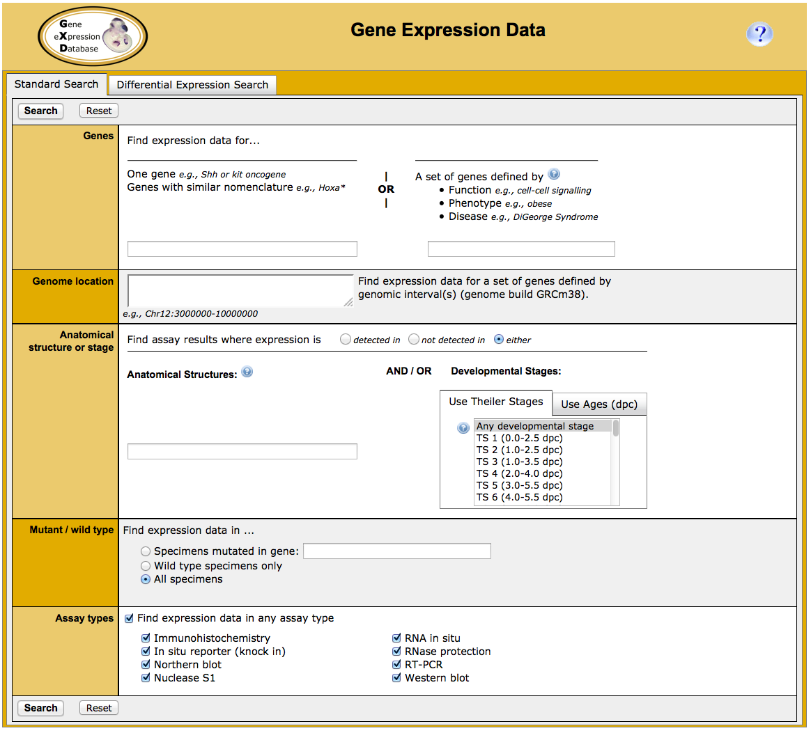
Wnt signaling pathway - Function

Slide 46
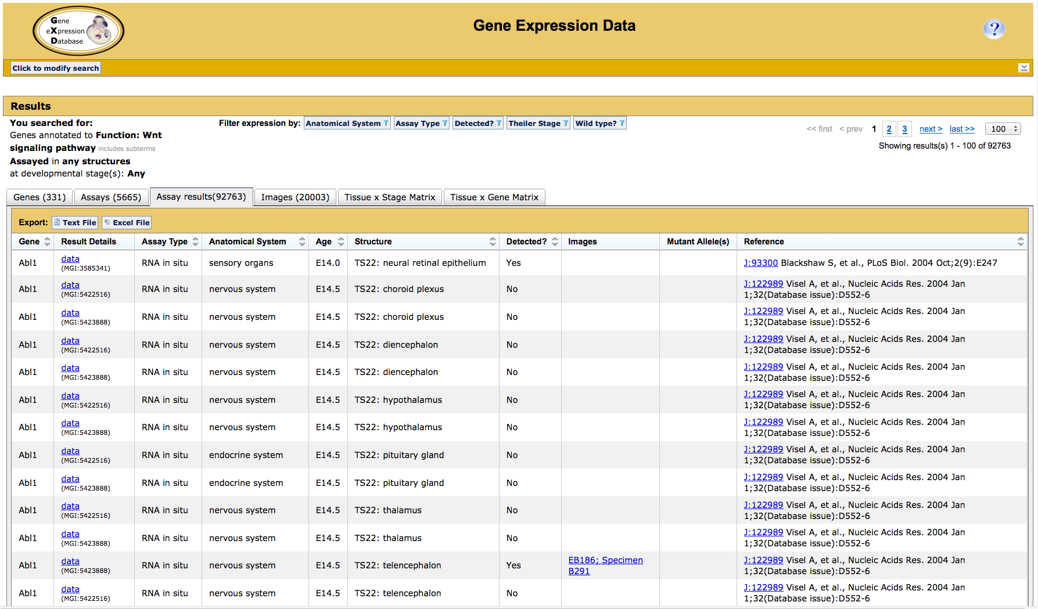
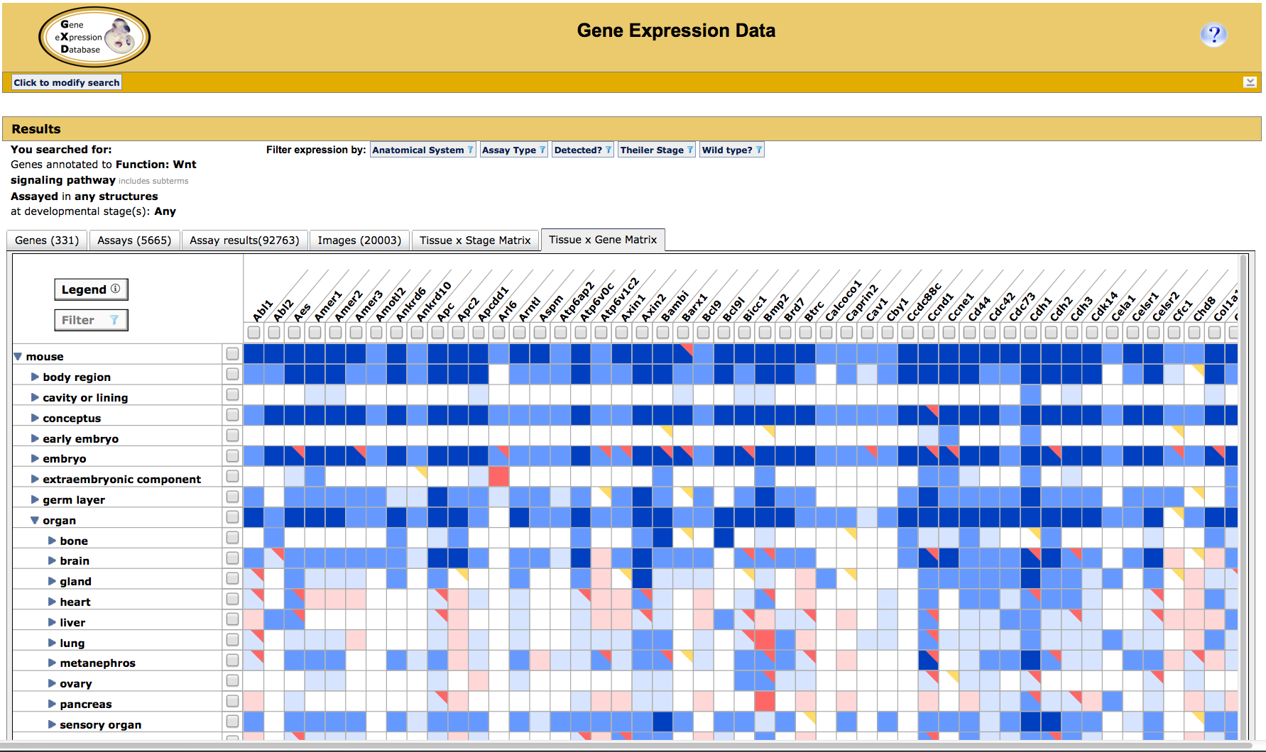
All expression data for genes with the FUNCTION: Wnt signaling pathway

Slide 47
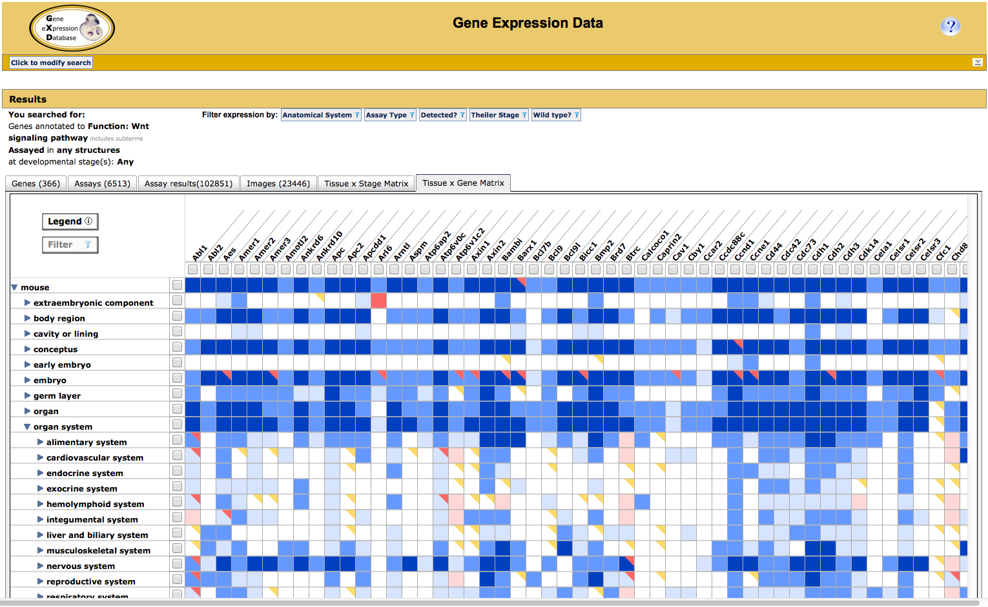
All expression data for genes with the FUNCTION: Wnt signaling pathway

Slide 48
Cre Portal

Slide 49
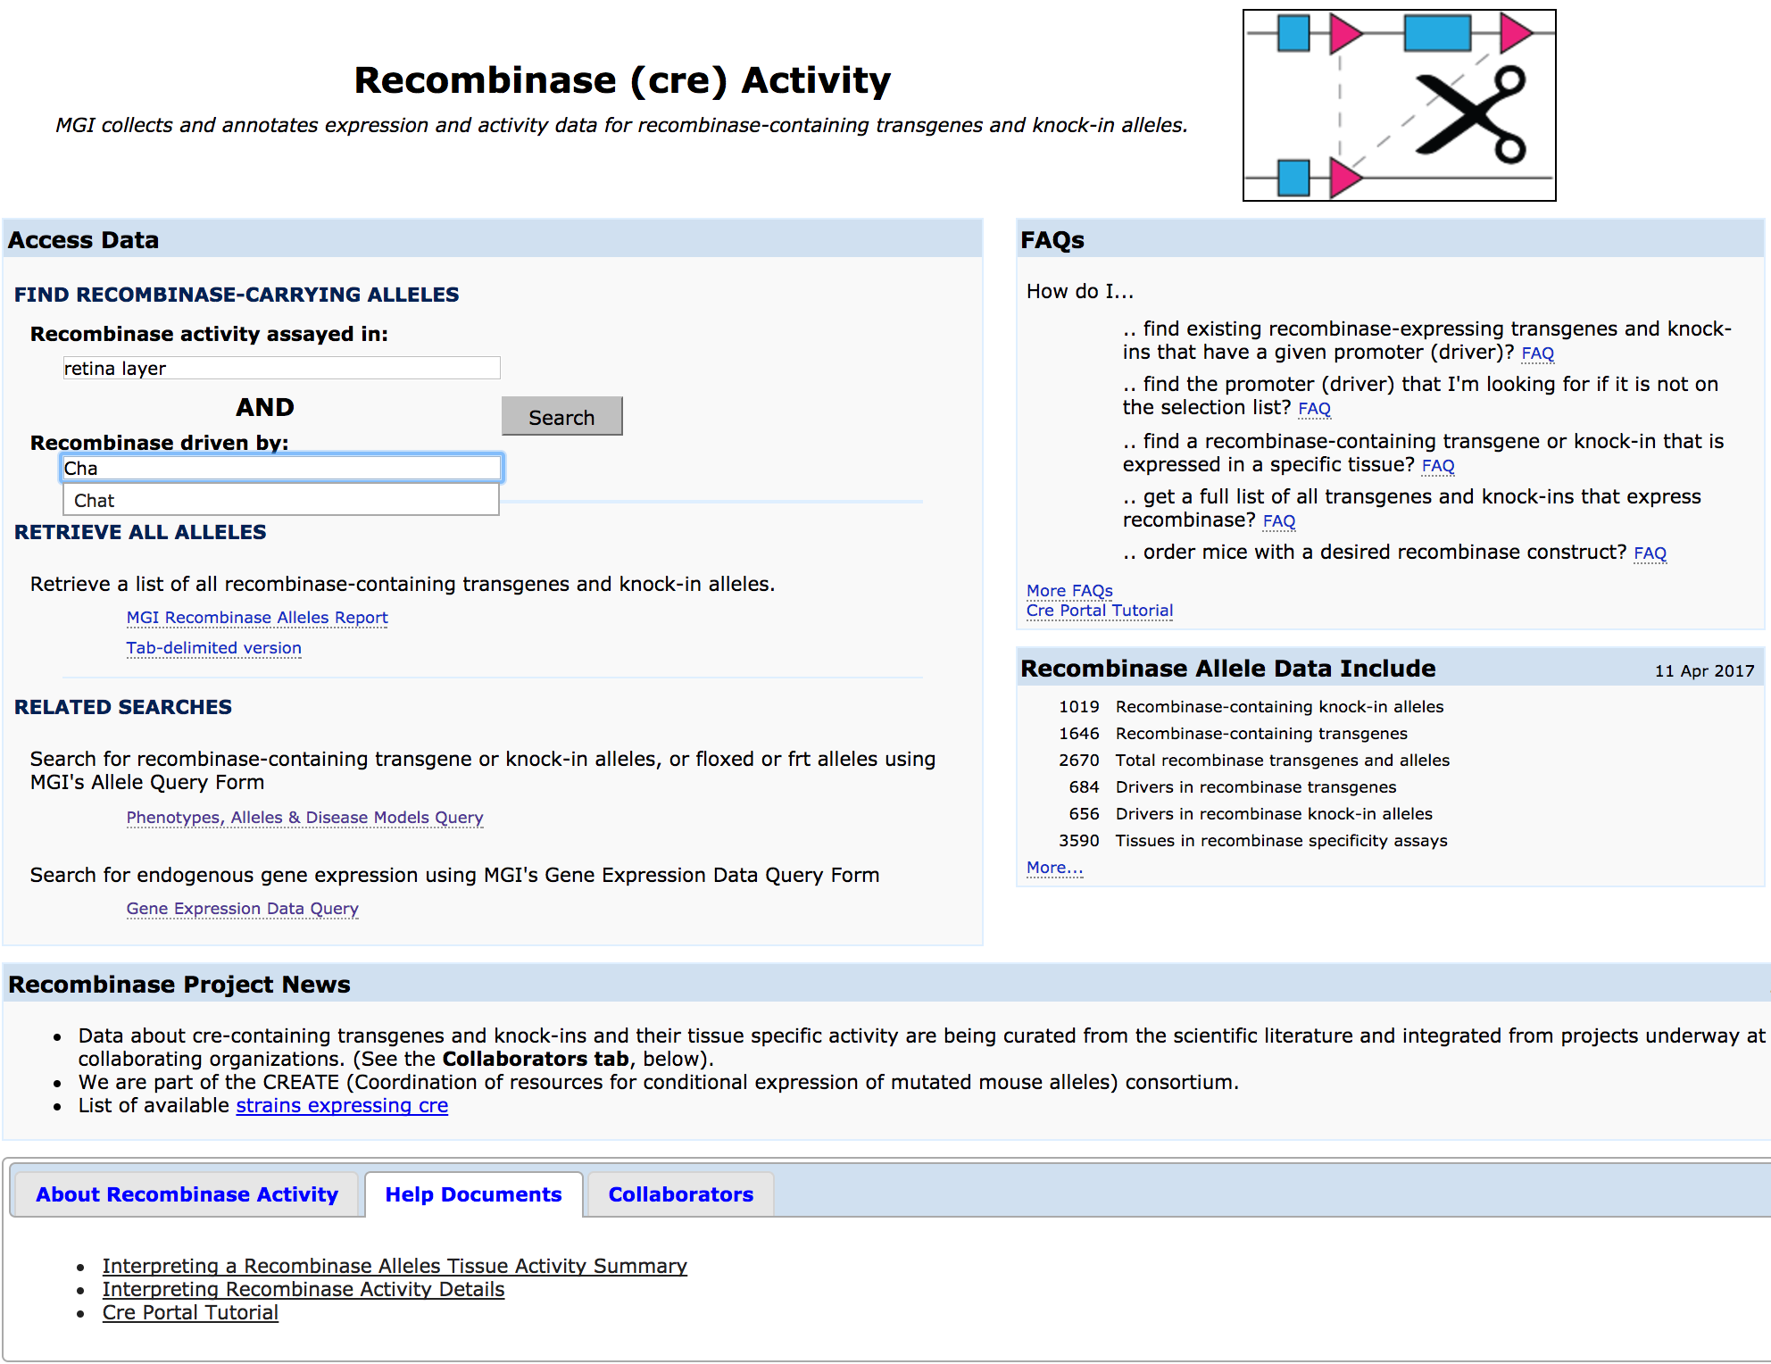

Slide 50
SNPs

Slide 51
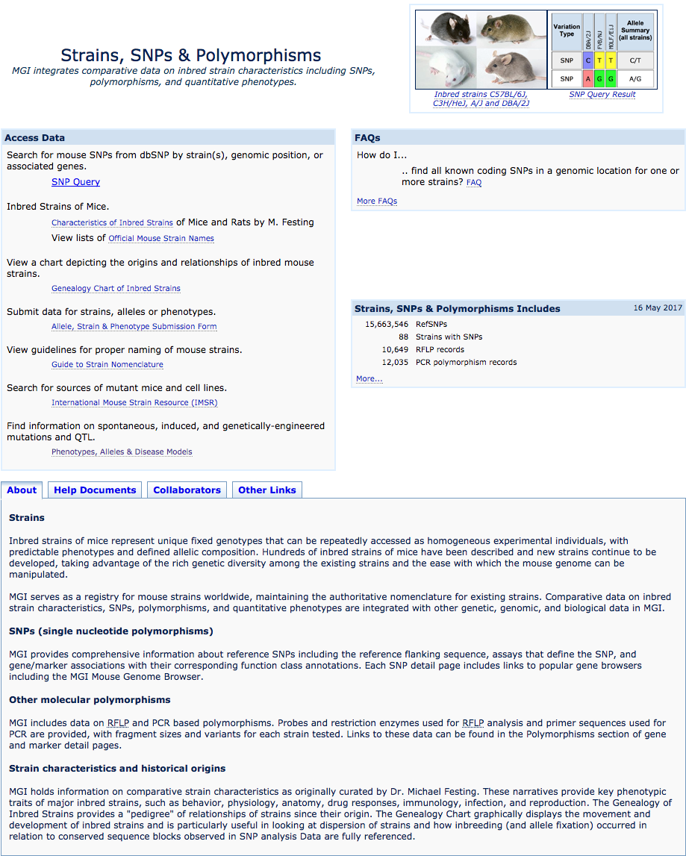

Slide 52
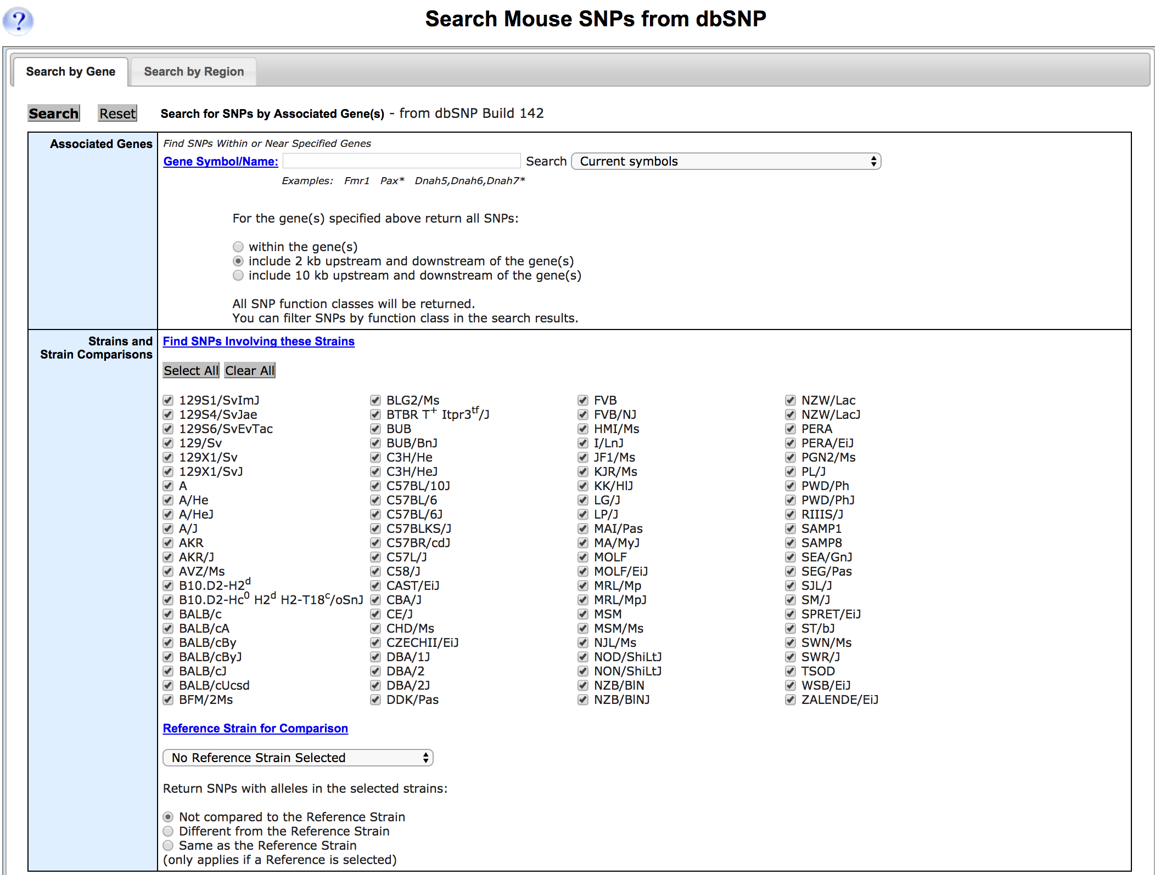
Help doc.

Slide 53
Bulk data analysis

Slide 54
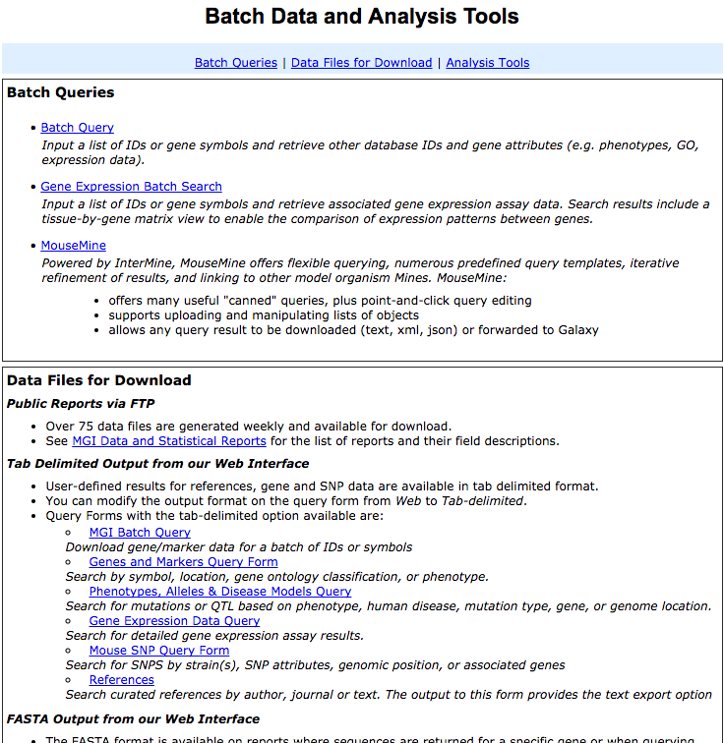

Slide 55
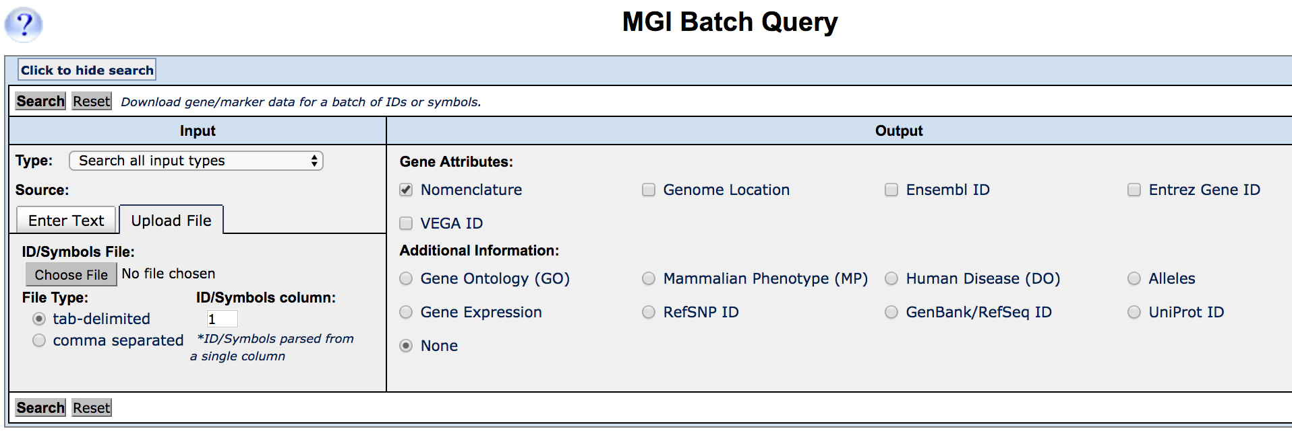
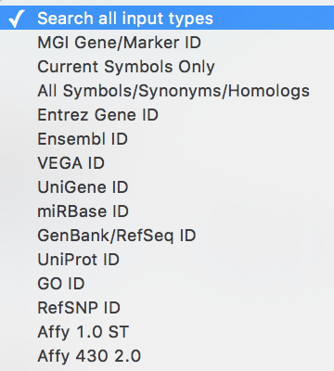
Help doc.
Output file options
Export search results

Slide 56
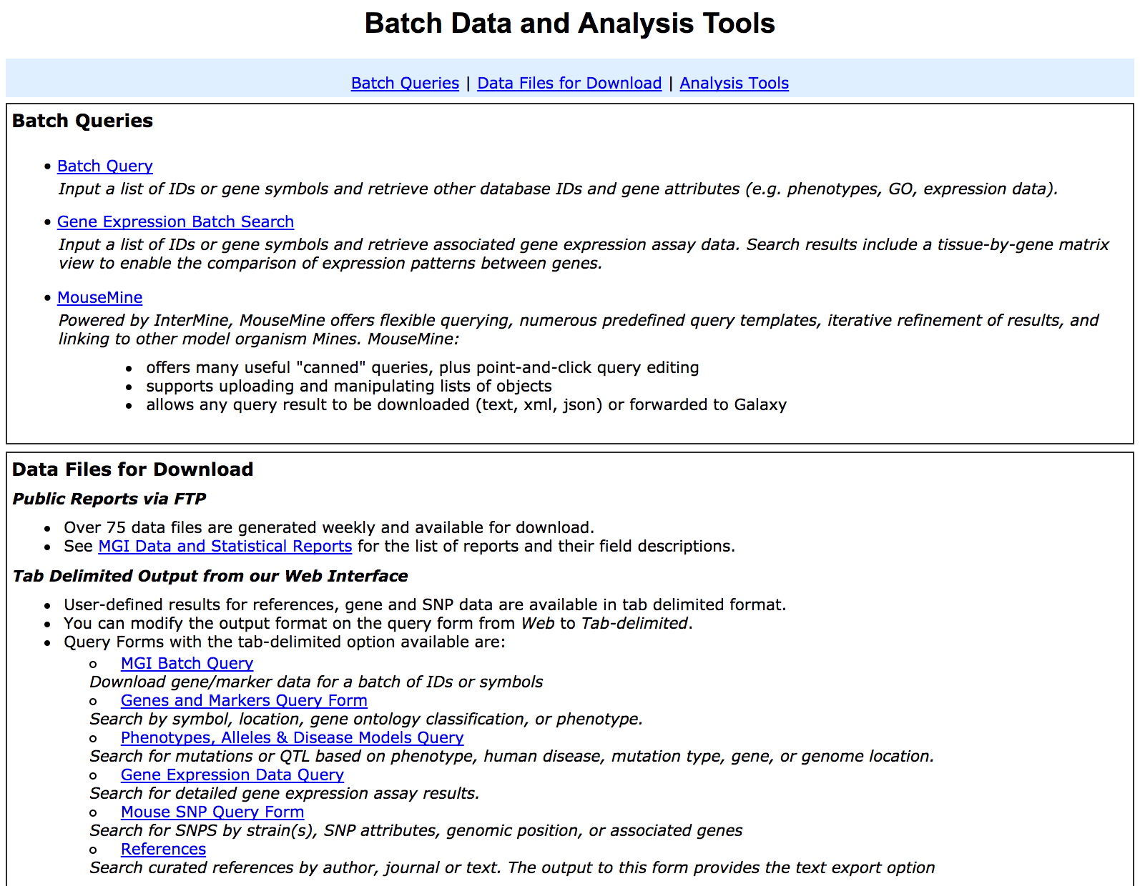

Slide 57
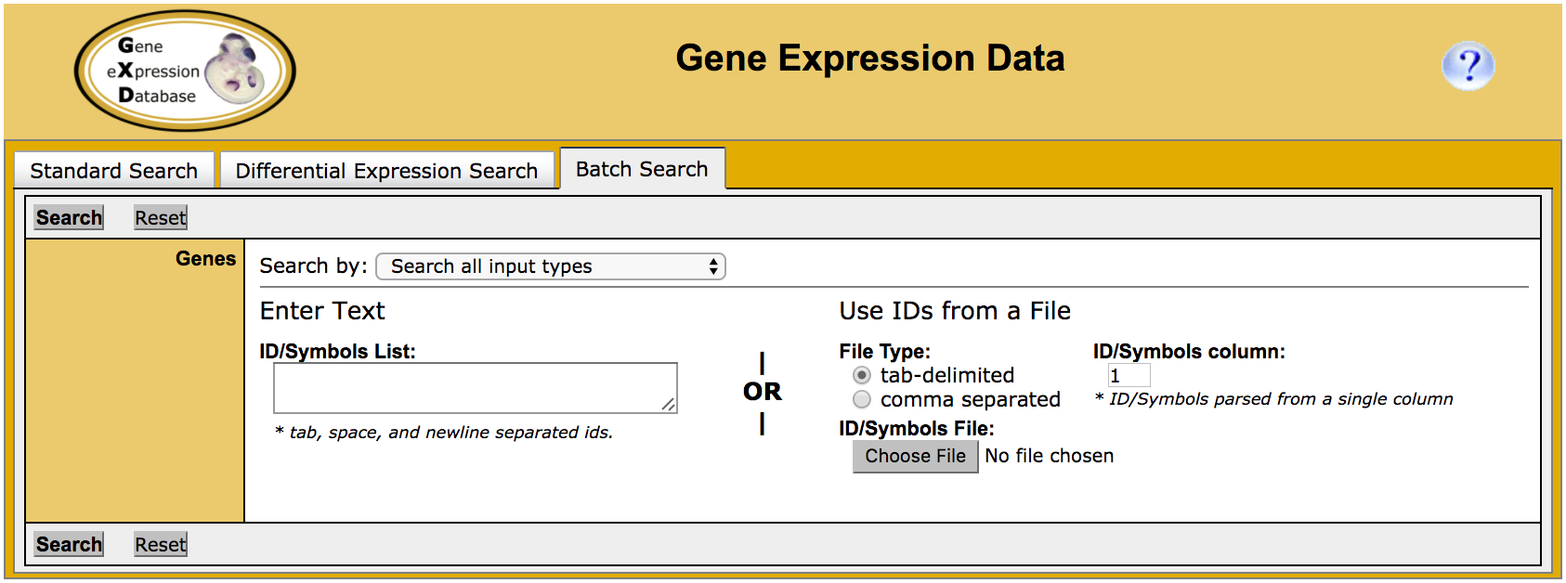
Help doc.
Search results can be saved as text, excel file or export to MouseMine

Slide 59
Create account to save your search
Section 7. Questions 26-20

Slide 61
Pre-defined template queries:
mmp9

Slide 62
Search results table
visibility
remove
filter
sort
column statistics
√
Notes:
Running the search returns a table with a pre-defined set of columns including ID, ontology namespace, ontology term and evidence.

Slide 64
Lists pane: upload, view existing or perform actions (union, subtraction, etc)

Slide 65
List
Add/remove columns
Sort and filter
Enrichment Widgets
Anatomy
Mammalian Phenotype
Gene Ontology
Chromosome
Templates
Run queries from list

